Slide 1
Welcome to CISSP Bootcamp
Certified Information Systems Security Professional
Kelly Handerhan, Instructor, Owner, CyberTrain.it
CISSP, CCSP, CISM, CRISC, PMP, Security+, etc.
KellyH@CyberTrain.IT

Slide 2
Welcome and Introduction

Slide 3

Welcome and Introduction
Kelly Handerhan, Instructor, Owner CyberTrain.IT
Over twenty years experience in Information Assurance, and Cybersecurity
Award-winning technical instructor
One of the original instructors for Cybrary.it
Certified in:
CISSP , CCSP, CISM, CRISC, PMP, Security+, Etc.
KELLY HANDERHAN, Instructor, Owner of CyberTrain.IT
KellyH@CyberTrain.IT

Slide 4
The CISSP Exam
What to Expect

Slide 5
The 8 Domains of CISSP
Domain 1: Security and Risk Management
Domain 2: Asset Security
Domain 3: Security Architecture and Engineering
Security Architecture and Design
Software Development Security (Domain 8)
Cryptography
Domain 4: Identity and Access Management
Domain 5: Communications and Network Security
Domain 6: Security Assessment and Testing
Domain 7: Security Operations
Redundancy
Continuity of the Enterprise
Domain 8: Software Development Security

Slide 6
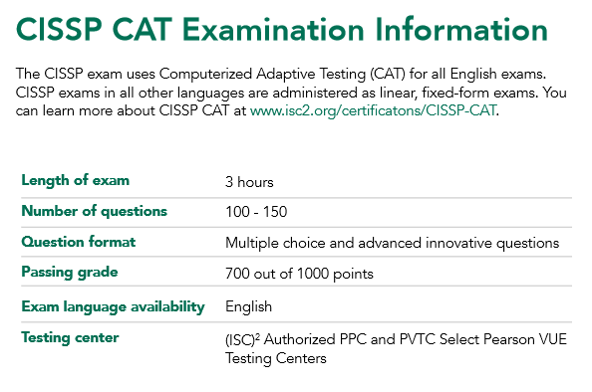
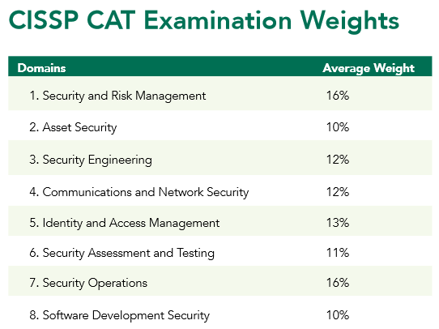
Computer Adaptive Testing (CAT)

Slide 7
How does CAT work?
Each time you answer a question, the system evaluates your ability to get the next question correct based on your previous answers and the complexity of the questions.
With each correct answer, the computer delivers more difficult questions as well as increases its estimate of your ability to pass– you get things right, questions gets harder, if you get things wrong then the questions get easier.
Answering more questions gives the system a greater gauge of your abilities.
Your answers to each question dictate what the next question will be. You can no longer go back to previous questions or mark questions for review
Once you reach the point where the system is confident of your ability, the exam will end and you will receive a “pass” on the exam.

Slide 8
The CISSP Mindset
Your Role is a Risk Advisor--Do NOT fix Problems
Who is accountable for security?
How much security is enough?
All decisions start with risk management. Risk management starts with Identifying and Valuation of your assets.
Think “End Game”
“Security Transcends Technology”
Physical safety is always the first choice
Technical Questions are for Managers. Management questions are for technicians
Incorporate security into the design, as opposed to adding it on later
Layered Defense!

Slide 9
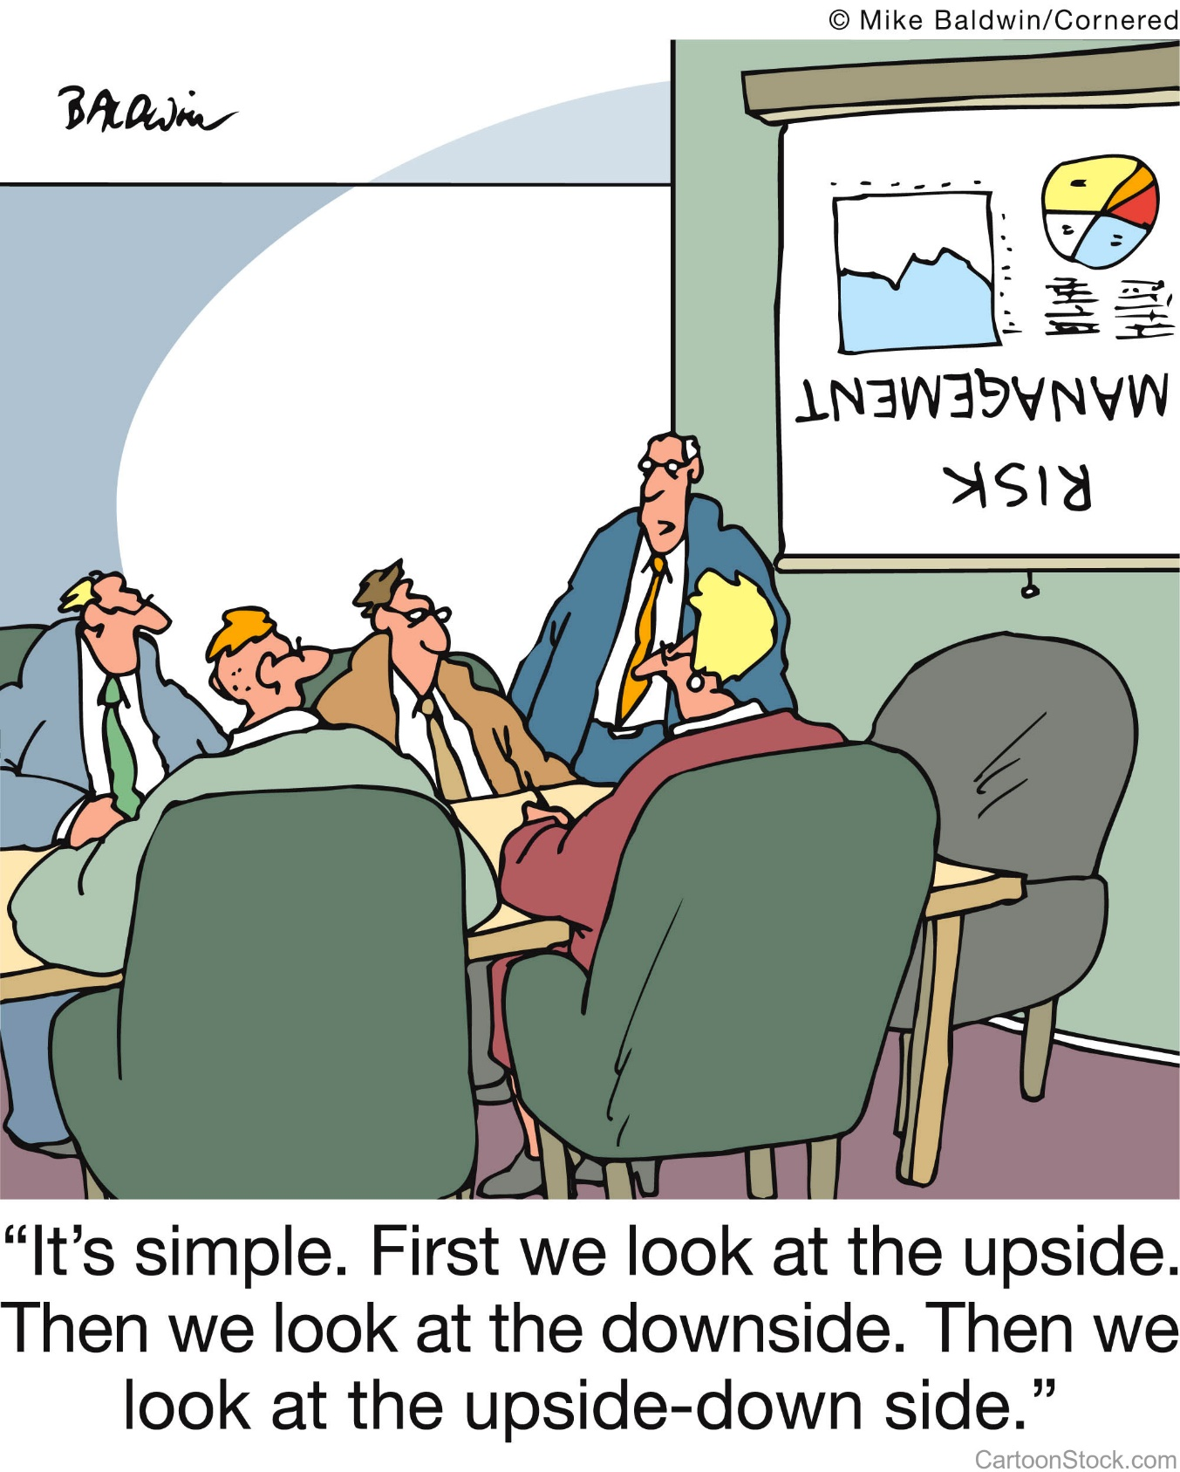
Domain 1
Information Security and Risk Management

Slide 10
Domain 1 Agenda Information Security and Risk Management
Principles of Information Security
Understanding GRC (Governance, Risk and Compliance)
Information Security Strategy and Roadmap
Information Security Frameworks
Information Security Program
Policies, Standards, Procedures, Guidelines
Roles and Responsibilities
Information Security Risk Management
Identification
Assessment
Mitigation
Monitoring
Legal Considerations
Knowledge Transfer
Notes:
This is perhaps the most testable domain on the CISSP exam because all decisions should revolve around risk management. Don’t go too deep in the technical aspects of a problem, when instead a change in the process would be a better long term solution.

Slide 11
Principles of Information Security

Slide 12
What is Security?
PROCESS
Strategic Planning
Management Systems
Frameworks
Alignment with Standards
Audit
A managed, risk-based approach to protecting the assets of an organization through applying controls relating to
People/Human
Processes/Organizational
Technology/Technical
PEOPLE
Training/awareness
Knowledge and Skill set
Company Culture
TECHNOLOGY
The success of the technology is driven by the people and processes of the organization
Notes:
Security requires that we manage the way people interface with technology. Processes control that access and can be used to mitigate the risk of users inappropriately accessing resources (greatest threat.) When ISC2 emphasizes “Security Transcends Technology” the purpose is to focus on the process. Many times organizations spend millions of dollars on technology, but if the foundation of a secure environment are not in place, then it will not matter. Senior management is accountable for appropriately protecting the assets for which they have been entrusted.

Slide 13
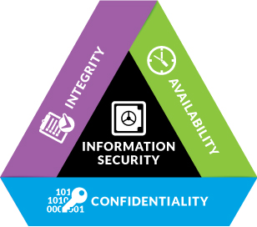
The Information Security Triad
Threats to the CIA
Confidentiality
Social Engineering
Eavesdropping
Media Reuse
Integrity
Corruption
Malicious Modification
Availability
Unavailability--Redundancy
Notes:
Threats to Confidentiality
Social Engineering--mitigating strategies: Training, separation of duties
Eavesdropping--mitigate by encryption or keep sensitive information off the network
Media reuse--covered later in this chapter, but ultimately mitigated by proper destruction of data (based on its value)
Threats to Integrity
Corruption (accidental)Mitigated by-- Hashes, message digests, checksums
Malicious modification-- Mitigated by message authentication codes, digital signatures
Threats to Availability--Mitigated through redundancy and resiliency

Slide 14
The Elements of Information Security:
NIST SP 800-12 revision 1
Information security supports the mission of the organization
Information security is an integral element of sound management
Information security protections are implemented so as to be commensurate with risk
Information security roles and responsibilities are made explicit
Information security responsibilities for system owners go beyond their own organization
Information security requires a comprehensive an integrated approach
Interdependencies of security controls
Other interdependencies Information security is assessed and monitored regularly
Information security is constrained by societal and cultural factors
Notes:
NIST SP 800-12 rev 1 replaced what was commonly known as GAISP (Generally Acceptable Information Security Principles) Though remembering the NIST document itself isn’t relevant for the test, the concepts listed above are.

Slide 15
Understanding GRC (Governance, Risk and Compliance)

Slide 16
What is GRC
In response to widescale fraud and the unethical behavior of numerous organizations in the early 2000’s, the Open Compliance & Ethics Group (OCEG) provided a set of published, open source standards addressing Principled Performance through GRC
Includes standards, guidelines, tools and online resources to address governance, risk management, compliance and ethics (GRC) for global corporations and other organizations
Directs organizations to meet objectives through
Sound, principled leadership
Addressing the unknown elements of the business
Maintaining compliance with laws and ethical behavior
https://www.oceg.org

Slide 17
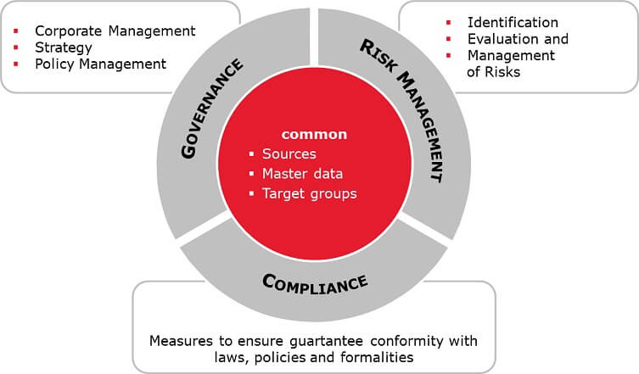
Understanding GRC
Principled Performance
https://www.oceg.org

Slide 18
The GRC Capability Model
Four Components of the GRC Capability Model
LEARN about the organization context, culture and key stakeholders to inform objectives, strategy and actions.
ALIGN strategy with objectives, and actions with strategy, by using effective decision-making that addresses values, opportunities, threats and requirements.
PERFORM actions that promote and reward things that are desirable, prevent and remediate things that are undesirable, and detect when something happens as soon as possible.
REVIEW the design and operating effectiveness of the strategy and actions, as well as the ongoing appropriateness of objectives to improve the organization.
https://www.oceg.org

Slide 19
Governance
Corporate Governance
Providing strategic vision and direction
Reaching security and business objectives
Ensure that risks are managed appropriately and proactively
Verify that the enterprise’s resources are used responsibly
Governance answers four questions:
1.Are we doing the right things?
2.Are we doing them the right way?
3.Are we getting them done well?
4.Are we getting the benefits?
IF the answer is no to any of these questions, how do we close the gap between current state and desired state?
Notes:
Corporate governance is ethical corporate behavior by directors and/or others charged with governance in the creation of value for stakeholders. Also includes the distribution of rights and responsibilities among different participants in the corporation, such as the board, management, shareholders and other stakeholders
Security Governance is a framework allowing the security goals and objectives of an enterprise to be set and expressed by senior management, communicated throughout the organization. Governance provides entities throughout the organization with the authority to implement and enforce security, and further provides oversight and a means to verify performance
Governance: the accountability for protection of the assets of an organization
Board of directors
Applicable to all departments and includes risk management
Value creation = benefits realization, risk optimization and resource optimization

Slide 20
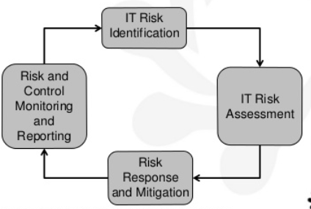
Risk

Slide 21
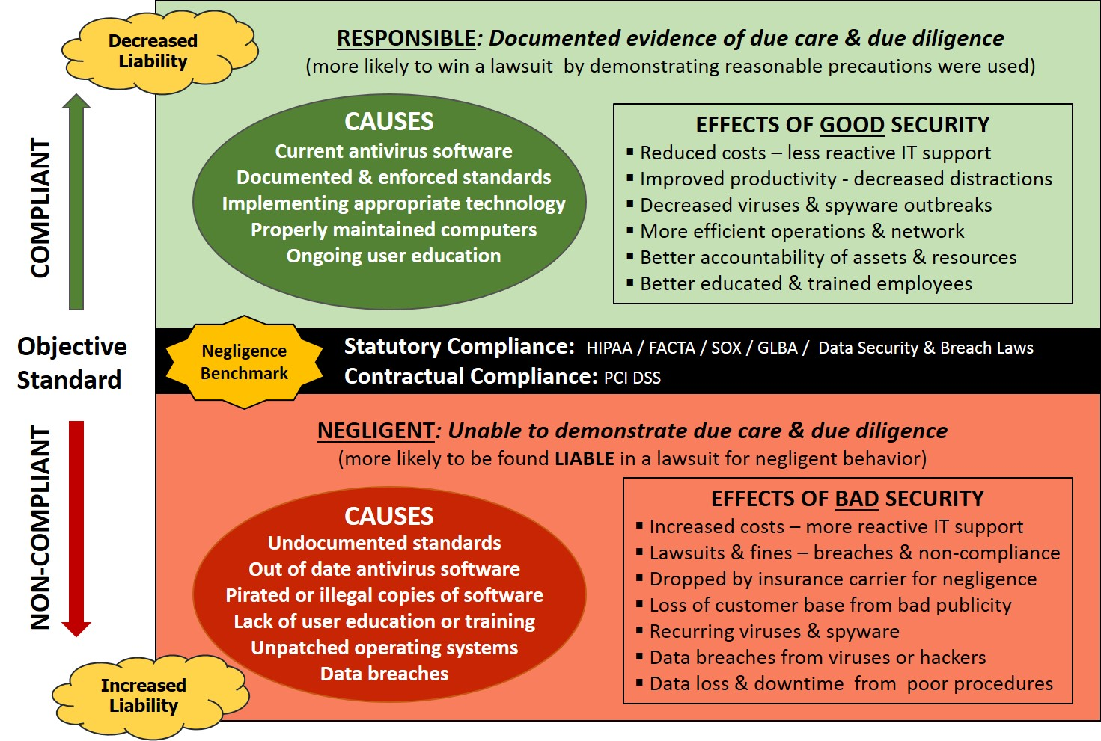
Compliance

Slide 22
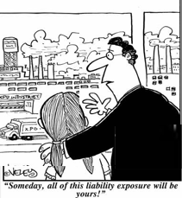
Liabilities
Who is responsible for the security within an organization?
Senior management
Are we liable in the instance of a loss?
Due Diligence
Due Care
Prudent Person Rule
Notes:
Due Care and Due Diligence
The information owner, senior management, has the responsibility of classifying data, dictating how it will be protected, and ensuring that only the necessary individuals access it. If anything happens to the data, they are ultimately responsible.
The owners are expected to practice due care. Due care means to take the necessary steps to protect assets, as in installing anti-virus or intrusion detection system (IDS) software.
Due diligence is the act of investigating and understanding the risks the company faces.
A company practices due care by developing security policies, procedures, and standards. Due care shows that a company has taken responsibility for the activities that take place within the corporation and has taken the necessary steps to help protect the company, its resources, and employees from possible risks.
Thus, due diligence is understanding the current threats and risks, and due care is implementing countermeasures to provide protection from those threats. If a company does not practice due care and due diligence pertaining to the security of its assets, it can be legally charged with negligence and held accountable for any ramifications of that negligence.
If a security incident took place and it was determined that the information owner was not practicing due care, then liability could easily lie at his doorstep.

Slide 23
The Information Security Strategy and Road Map

Slide 24
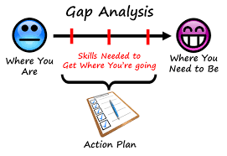
Gap Analysis
Information Security Strategy and Road Map

Slide 25
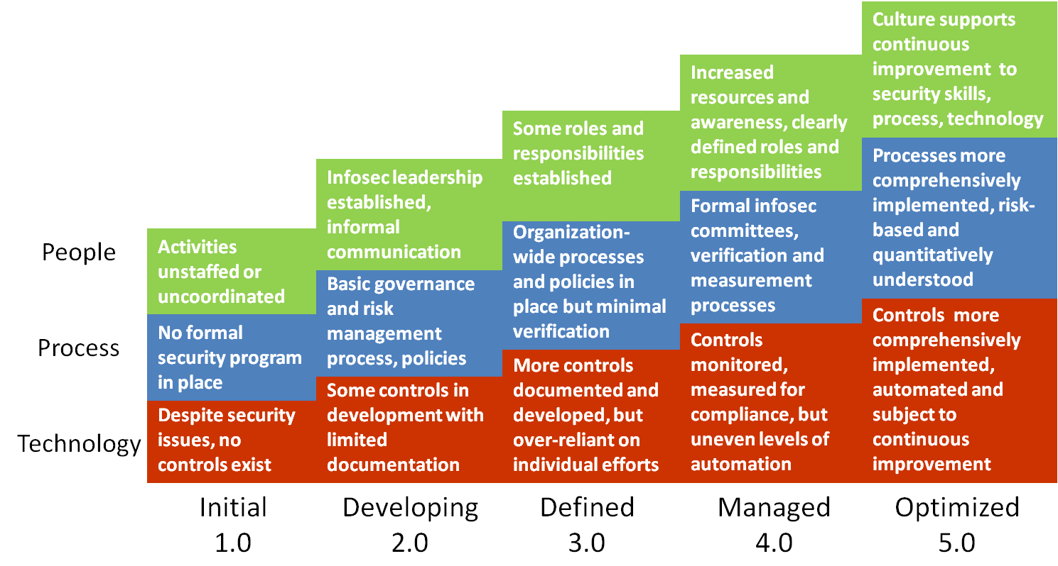
Gap Analysis using the CMMI
Repeatable
Notes:
Capability Maturity Models, such as the CMMI from Carnegie Mellon evaluate an organization on the maturity of its processes. Usually for compliance, or to meet customer requirements an organization may need to pursue a rating from 1-5 from CMMI. Gap analysis looks at the current state vs. the desired state and helps us close the gap.

Slide 26
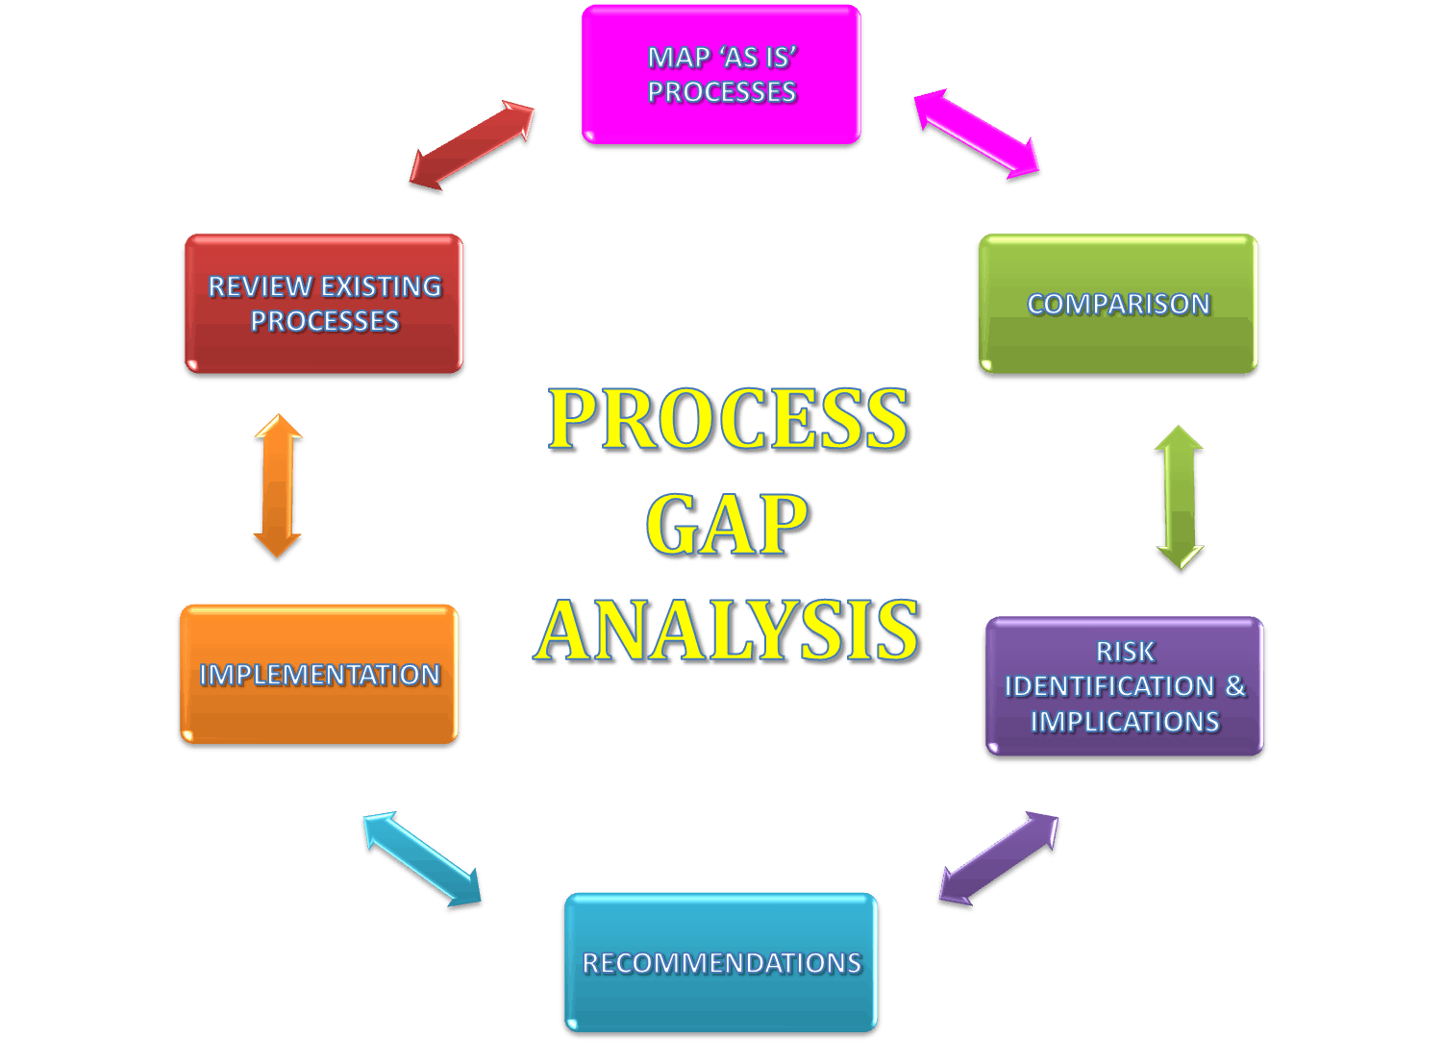
Closing the Gap: Information Security Strategy
Long term perspective to help move the organization from current state to desired state as detailed in gap analysis
Standard throughout the organization
Aligned with business strategy/direction
Understands the culture of the organization
Reflects business needs and priorities
Notes:
The purpose of a strategic plan for security is to provide management with the necessary information to make informed decisions about investment in security. The strategic plan links the security function with the business direction. The strategy must present a business case that describes key business benefits and outcomes related to security, with recommended strategies for achieving those outcomes. Long term vision for the organization is the responsibility of senior management and should be understood throughout the organization. Each department or division within the enterprise should be working in alignment to achieve the desired state.

Slide 27
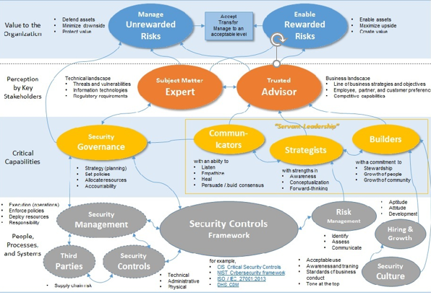
A Road Map provides a visual illustration of strategy

Slide 28
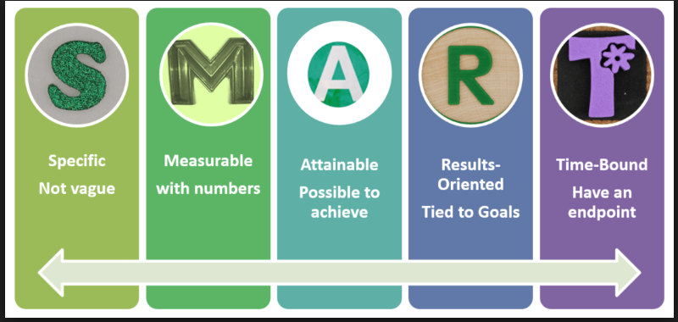
Objectives of an Information Security Strategy
Begin with an understanding of the long-term objectives of the organization. Strategy should describe a well-articulated vision of the desired outcomes for a security program through SMART objectives
Notes:
Short-term objectives help us accomplish long term goals.
Example of a security strategy objective – Protect the confidentiality of customer PII
Key initiative – Strengthen policies and standards clarifying requirements for data protection (These are usually the gaps that were found in the risk assessment.)
Enables objectives – Confidentiality of information, improved security of systems & network services, proactive data security and governance.
Description – Develop, approve, and launch a suite of information security policies, standards, and guidelines based on ISO/IEC 27001.
Key benefits – These benefits need to be aligned with the business.
Clear security baselines for all departments
Policy-based foundation to measure results
Consistent application of security controls across the enterprise
Project – listed technology, service, etc. that will meet the objective.

Slide 29
Information Security Frameworks

Slide 30
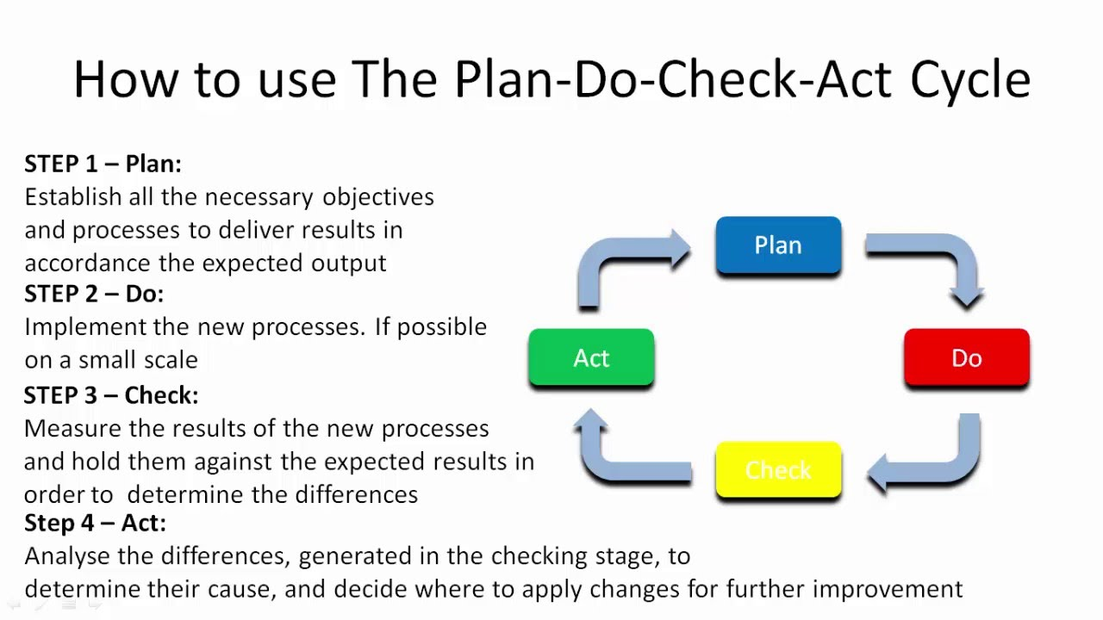
Frameworks: ISO 27001
Standard Framework for implementing and managing an ISMS based on the PDCA model
Requires senior management to
Systematically examine the organization's information security risks, taking account of the threats, vulnerabilities, and impacts;
Design and implement a coherent and comprehensive suite of information security controls and/or other forms of risk treatment (such as risk avoidance or risk transfer) to address those risks that are deemed unacceptable; and
Adopt an overarching management process to ensure that the information security controls continue to meet the organization's information security needs on an ongoing basis.
Notes:
ISO 27001 is a formal standard against which organizations can be certified. ISO 27002 (and other ISO documents) provide assistance with implementation. For instance, ISO 27001 provides a management system in which information security must be planned, implemented, monitored, reviewed, and improved. It means that management has its distinct responsibilities, that objectives must be set, measured and reviewed, that internal audits must be carried out and so on. All those requirements are defined in ISO 27001. Practical implementation and further detail is provided in ISO 27002. For instance ISO 27001 may indicate that access control is essential, but one would look to ISO 27002 to understand the various ways to enforce access control. In reality the two documents are closely related, whereas ISO 27002 is one (of many) tools to accomplish ISO 27001 certification

Slide 31
ISO 27002: The 14 Domains
Information Security Policies
Organization of Information Security
Human Resource Security
Asset Management
Access Control
Cryptography
Physical and environmental security
Operation Security
Information security reviews
Communication Security
System acquisition, development and maintenance
Supplier relationships
IS Incident management
IS aspects of BCP
Compliance with legal and contractual requirements
Notes:
Provides best practice recommendations on information security controls for use by those responsible for initiating, implementing or maintaining information security management systems (ISMS).
Information security is defined in the context of the C-I-A triad:
The preservation of confidentiality (ensuring that information is accessible only to those authorized to have access)
The preservation of integrity (safeguarding the accuracy and completeness of information and processing methods)
The preservation of availability (ensuring that authorized users have access to information and associated assets when required)

Slide 32
Other Common Frameworks
SABSA(Sherwood Applied Business Security Architecture)
TOGAF (The Open Group Architecture Framework)
COBIT (Control Objectives for Information and related Technology)
COSOERM and COSO IC
Business Model for Information Security
Six Sigma
Model originated at the Institute for Critical Information Infrastructure Protection
Publications from NIST and ISF
US Federal Information Security Management Act (FISMA)
Securing quality
ISO standards on quality (ISO 9001:2000)
Notes:
These other frameworks are not testable, but are used in numerous environments

Slide 33
Information Security Program

Slide 34
Information Security Program
Provides the means for achieving strategy
Policies/Standards/Procedures/Guidelines
Roles and Responsibilities
SLA's Service Level Agreements/Outsourcing
Data Classification/Security
C&A (Certification and Accreditation
Auditing
Notes:
The information security program should be based on a comprehensive risk analysis. The controls that are implemented are a direct result of the risk mitigation strategy, and should provide a positive return on investment (keeping in mind that costs/benefits are not always monetary). You can think of the security program as the set of controls we implement to bring residual risk down to an acceptable level.

Slide 35
Information Security Program
Provides the means for achieving strategy
Policies/Standards/Procedures/Guidelines
Roles and Responsibilities
SLA's Service Level Agreements/Outsourcing
Data Classification/Security
C&A (Certification and Accreditation
Auditing
Notes:
The information security program should be based on a comprehensive risk analysis. The controls that are implemented are a direct result of the risk mitigation strategy, and should provide a positive return on investment (keeping in mind that costs/benefits are not always monetary). You can think of the security program as the set of controls we implement to bring residual risk down to an acceptable level.

Slide 36
Types of Policy
Three main types of policies exist:
Corporate Policy
System Specific Policy
Issue Specific Policy
Notes:
The Corporate (Organizational) Security Policy can be thought of as a blueprint for the whole organization’s security program. It is the written document that indicates the organization’s approach to security and voices senior management’s commitment to support the security function. Addresses issues like the C-I-A triad, authenticity, and compliance with regulations and other drivers.
A System-specific policy is concerned with a specific or individual computer system. It is meant to present the approved software, hardware, and hardening methods for that specific system.
An Issue-specific policy is concerned with a certain functional aspect that may require more attention. For this reason, a separate policy is prepared for that issue to explain with details the required level of security, and the instructions that all staff in the organization must abide by to achieve this level.

Slide 37
Issue Specific Policies
Change Management Policy
Acceptable Use Policy
Privacy
Data/System Ownership
Separation of Duties (SOD)
Mandatory Vacations
Job rotation
Least privilege
Need to know
Dual control
M of N control
Notes:
Change Management Policy: all changes to baseline security configuration must be submitted for approval, approved, tested, documented, scheduled, implemented, monitor. NOTHING HAPPENS ON THE FLY
Acceptable Use Policy: Management's expectation for how company resources are to be used
Privacy: Privacy can be infringed upon, but employees must be notified
Data/System Ownership: Can’t always assume senior management is the owner. For instance, patients maintain ownership of their Personal Healthcare Information, even though they may share it with a doctor
Separation of Duties: Protects against a single individual having too much power, makes sure there is a clear reporting path that is unconflicted, and forces employees to collude with someone else to commit fraud
Mandatory Vacations: Frequently used in banking or other financial industries. Used as a detective control, for investigations while the employee is on a mandated leave from work.
Job Rotation: Serves as a detective control, but also provides redundancy of personnel
Least Privilege: Employees are granted the ability to perform only the actions they need to perform their jobs.
Need to Know: Employees are granted access to only the data they need to perform their work
Dual Control: Prevents abuse of power. For instance, Admin A and Admin B both must enter their passwords in order to recover private keys from archival
M on N Control is an extension of dual control, but is not dependent on specific employees being present. M and N are simply variables. Example: Any 4 out of 9 network admins must be present to recover private keys from archival

Slide 38
Standards
Mandatory
Created to support policy, while providing more specifics details.
Reinforces policy and provides direction
Can be internal or external
Notes:
Whereas policies are few and broad, standards fill in the specifics. A policy may indicate that all PII data must be encrypted, and they standard defines the current encryption algorithm to be used is AES 256

Slide 39
Procedures
Mandatory
Step by step directives on how to accomplish an end-result.
Detail the “how-to” of meeting the policy, standards and guidelines

Slide 40
Guidelines
Not Mandatory
Suggestive in Nature
Recommended actions and guides to users
“Best Practices”

Slide 41
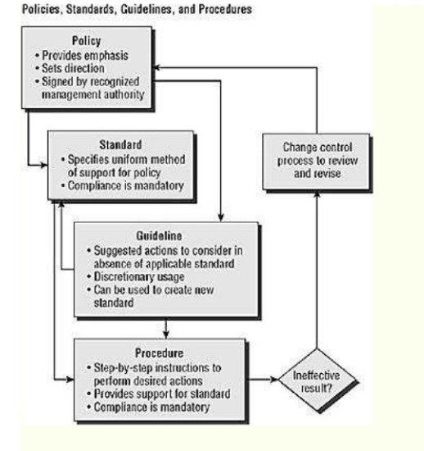
Standards: What?
Policies: Why?
Guidelines
Procedures: How ?

Slide 42
Baselines
Mandatory
Minimum acceptable security configuration for a system or process
The purpose of security classification is to determine and assign the necessary baseline configuration to protect the data
Notes:
Baselines are often implemented through the use of images. Different images are needed to support different operating systems and are used for variance control purposes, as well as to determine and control changes to systems.

Slide 43
Roles and Responsibilities

Slide 44
Senior Management’s Responsibilities
Senior Management is ultimately responsible to:
Provide oversight
Provide funding and support
Ensure testing (and that appropriate results are achieved)
Prioritize business functions
Establish a common vision/strategy/framework for the enterprise
“Sign off” on Policy, BIA and other organizational documents
Notes:
The purpose of a strategic plan for security is to provide management with the necessary information to make informed decisions about investment in security. The strategic plan links the security function with the business direction. The strategy must present a business case that describes key business benefits and outcomes related to security, with recommended strategies for achieving those outcomes. Long term vision for the organization is the responsibility of senior management and should be understood throughout the organization. Each department or division within the enterprise should be working in alignment to achieve the desired state.

Slide 45
Steering Committee
Oversight of Information Security Program
Acts as Liaison between Management, Business, Information Technology, and Information Security
Assess and incorporate results of the risk assessment activity
into the decision-making process
Ensures all stakeholder interests are addressed
Oversees compliance activities

Slide 46
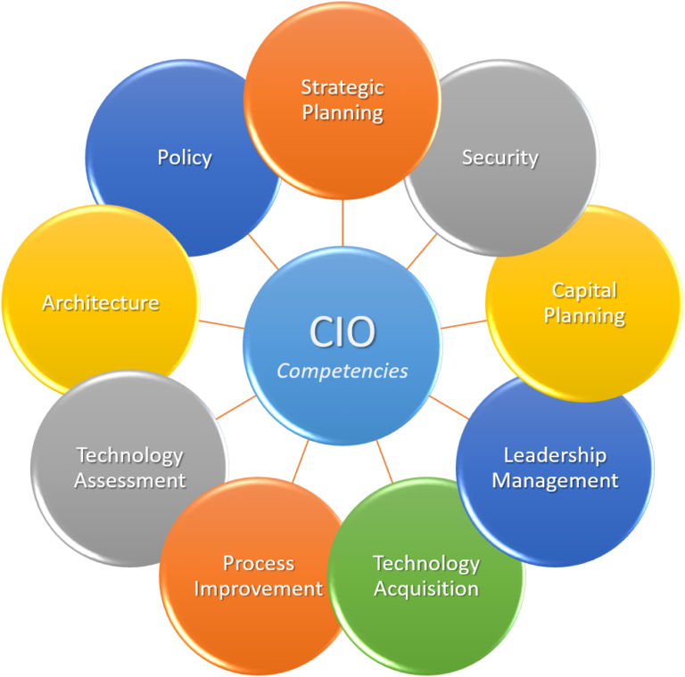
Chief Information Security Officer (CISO)
Strategic Planning
Policy Development
Technology Assessments
Process Improvement
Acquisitions
Capital Planning
Security
Notes:
The CISO isthe senior manager ultimately responsible for providing C-I-A for information assets.
Responsible for protecting the CIA of information through the following:
Policy
Investigation
Testing
Compliance
IT planning, budgeting, and performance, including its information security components

Slide 47
Information Security Manager
Functional Manager, responsible for achieving for determining the “how”
Play a leading role in introducing an appropriate, structured methodology
Act as major consultants in support of senior management

Slide 48
Business Managers
Responsible for business operations
Provide direction to ensure security is implemented in such a way as to meet business objectives
Responsible for security enforcement and direction
Responsible for day-to-day
Monitoring
Reporting
Disciplinary actions
Compliance
Notes:
Business managers are often our customers as we fulfil our role in information security. Remember, our ultimate purpose is to support the objectives of the business, the business managers are the ones who are closest to the business and are often owners of the systems and the data. If there is ever a conflict between InfoSec and the business function owner, the business will always be the ultimate decision makers.

Slide 49
Security Practitioners
Responsible for proper implementation of security requirements in their IT systems
Support or use the risk management process to identify and assess new potential risk and implement new security controls as needed to safeguard their IT systems

Slide 50

Auditors
Objective Evaluation of controls and policies to ensure that they are being implemented and are effective.
If internal auditing is in place, auditors should not report to the head of a business unit, but rather to the Chief Operating Officer or some other entity without direct stake in result
Auditors document and do not modify

Slide 51
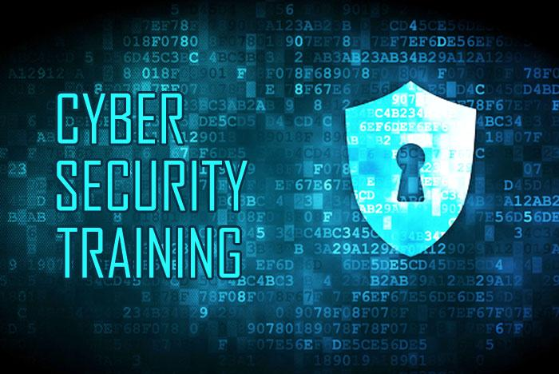
Security Trainers
Must understand the risk management process
Develop appropriate training materials
Conduct security trainings and awareness programs catered to roles within the organization
Incorporate risk assessment into training programs to educate the end users
Encourage users to report violations

Slide 52
Information Security Risk Management

Slide 53
Information Security Risk Management
Information security risk management, or ISRM, is the process of managing risks associated with the use of information technology. It involves identifying, assessing, and treating risks to the confidentiality, integrity, and availability of an organization's assets.

Slide 54
Risk Definitions
Asset: Anything of Value to the company
Vulnerability: A weakness; the absence of a safeguard
Threat: Something that could pose loss to all or part of an asset
Threat Agent: What carries out the attack
Exploit: An instance of compromise
Risk: The probability of a threat materializing
Controls: Physical, Administrative, and Technical Protections
Safeguards
Countermeasure
Total Risk: The risk that exists before any control is implemented
Residual Risk: Leftover risk after applying a control
Secondary Risk: When one risk response triggers another risk event
Incident: A risk event that has transpired

Slide 55
Risk Management Steps
Risk Identification
Identify and determine the value for assets
Identify Threats and Vulnerabilities
Risk Assessment (Value)
Qualitative vs. Quantitative
Risk Mitigation/Response
Reduce
Accept
Transfer
Avoid
Reject
Ongoing Controls Evaluation

Slide 56
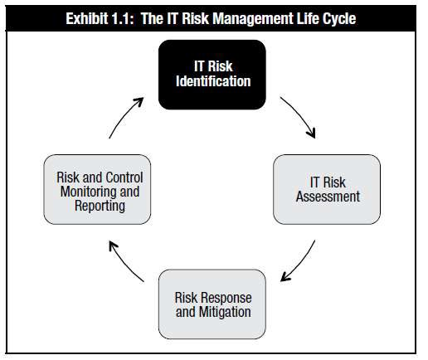
Risk Management Life Cycle:
Risk Identification

Slide 57
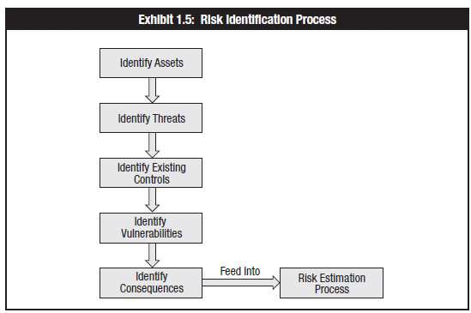
Risk Identification
Risk Assessment Process

Slide 58
Methods to Identify Risk
Sources of risk documentation
Audit reports Incident reports
Interviews with SMEs Public media
Annual reports
Press releases
Vulnerability assessments and penetration tests
Business continuity and disaster recovery plans
Interviews and workshops
Threat intelligence services

Slide 59
Alignment with Business Goals and Objectives
The first and most important step for a CISM is to understand the business. Review organizational vision and strategy FIRST
Look beyond IT—Risk is measured by the impact the risk has on the business, not on a particular system
In order for risk to be integrated into the enterprise, senior management must be supportive and involved.
If management funds and supports the risk management processes we will have what we need to be successful
Good metrics mean that we have attainable objectives which will help us accomplish our goals
Good communication and transparency helps us make risk-aware business decisions

Slide 60
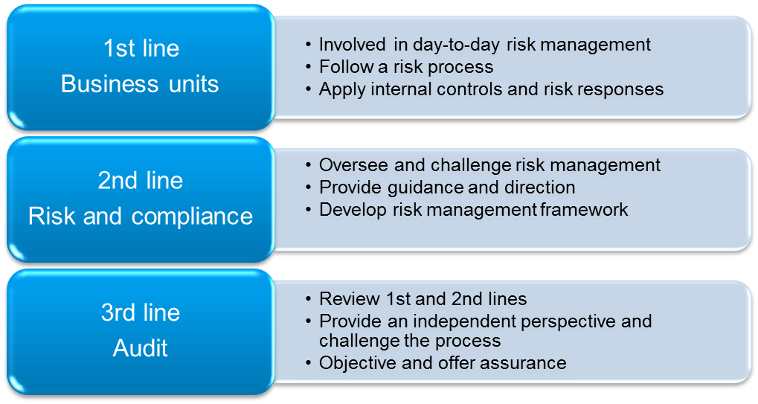
Organizational Structures and Impact on Risk
Risk Context
Risk management approach should be enterprise wide and a common framework should be shared across all departments
Three lines of defense
RACI Charts can be used to indicate responsibilities

Slide 61
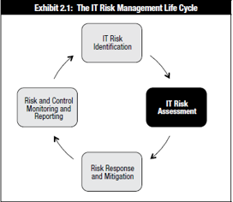
Risk Management Life Cycle:
Risk Assessment

Slide 62
Risk Assessment/Analysis
Qualitative
Subjective analysis to help prioritize probability and impact of risk events.
May use Delphi Technique
Quantitative:
Providing a dollar value to a particular risk event.
Much more sophisticated in nature, a quantitative analysis if much more difficult and requires a special skill set
Business decisions are made on a quantitative analysis
Can't exist on its own. Quantitative analysis depends on qualitative information
Notes:
Risk Approach: Quantitative vs. Qualitative
There are two basic ways of performing a risk assessment, quantitative and qualitative. The quantitative approach deals with numbers. It attempts to assign numeric values to assets and present the potential losses in monetary values. Qualitative does not apply monetary values to items but uses a type of rating system instead. For example, if a qualitative analysis was going to be performed, the analysis team can ask different department representatives and IT individuals to rate specific risks on a scale of 1-5 to determine which risks the employees see as most dangerous. The team could then ask the same individuals to rate the recommended countermeasures on what they see as the best solutions.
The quantitative approach tries to assign assets and risks monetary values because that format easily integrates into business plans and budgets and allows management to see how certain items affect their bottom line. The qualitative approach has a different goal, which is to get the “gut feeling” about the risks and the necessary solutions of the people closest to the problem who are seen as experts within their company.
Note
The Delphi method allows people to express their ideas anonymously

Slide 63
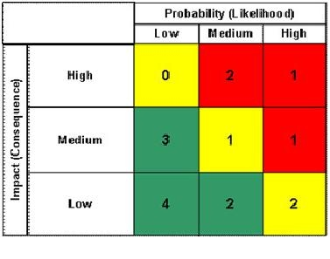
Qualitative Assessments
Assess risks based on subjective input
Uses terms like high, medium, low
Inexpensive, and quick way to begin the prioritization and ranking of risks
Notes:
Qualitative analysis always proceeds quantitative analysis. A purely quantitative analysis is not possible.

Slide 64
Quantitative Analysis
More experience required than with Qualitative
Involves calculations to determine a dollar value associated with each risk event
Business Decisions are made on this type of analysis
Goal is to the dollar value of a risk and use that amount to determine what the best control is for a particular asset
Necessary for a cost/benefit analysis

Slide 65
Quantitative Analysis Formulas and Terms
(AV) Asset Value: Dollar figure that represents what the asset is worth to the organization
(EF) Exposure Factor: The percentage of loss that is expected to result in the manifestation of a particular risk event.
(SLE) Single Loss Expectancy: Dollar figure that represents the cost of a single occurrence of a threat instance
(ARO) Annual Rate of Occurrence: How often the threat is expected to materialize
(ALE) Annual Loss Expectancy: Cost per year as a result of the threat
(TCO) Total Cost of Ownership is the total cost of implementing a safeguard. Often in addition to initial costs, there are ongoing maintenance fees as well.
(ROI) Return on Investment: Amount of money saved by implementation of a safeguard. Sometimes referred to as the value of the safeguard/control.

Slide 66
Quantitative Analysis Formulas
SLE = AV * EF
ALE = SLE * ARO
TCO = Initial Cost of Control + Yearly fees
ROI= Return on Investment:
ALE (before implementing control)
– ALE (after implementing control)
– cost of control
= ROI (Value of Control)
Notes:
(AV) Asset Value: Dollar figure that represents what the asset is worth to the organization
(EF) Exposure Factor: The percentage of loss that is expected to result in the manifestation of a particular risk event.
(SLE) Single Loss Expectancy: Dollar figure that represents the cost of a single occurrence of a threat instance
(ARO) Annual Rate of Occurrence: How often the threat is expected to materialize
(ALE) Annual Loss Expectancy: Cost per year as a result of the threat
(TCO) Total Cost of Ownership is the total cost of implementing a safeguard. Often in addition to initial costs, there are ongoing maintenance fees as well.
(ROI) Return on Investment: Amount of money saved by implementation of a safeguard. Sometimes referred to as the value of the safeguard/control.

Slide 67
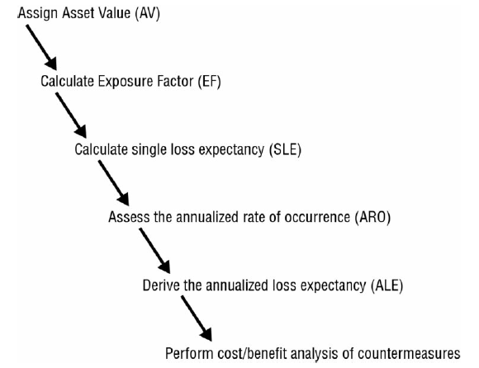
Steps for Quantitative Analysis

Slide 68
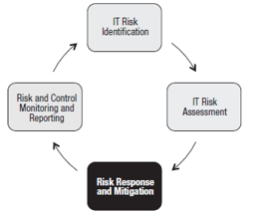
Risk Management Life Cycle:
Risk Response and Mitigation

Slide 69
Risk Mitigation and Response
Risk Assessment will dictate the appropriate risk response
Reduce
Avoidance
Transfer
Accept
Rejection
Notes:
The three preferred methods are Reduce, Accept, Transfer
Reduce: Lessen the probability or an impact of a risk
Accept: Choose that the risk amount is within the organization's tolerance for loss. No control is implemented
Transfer: Share the risk with someone else. Ex: SLAs, Outsourcing, Insurance
Avoidance: Remove all elements of risk. Choose not to implement a technology because the risks are too high.
Rejection: Not an acceptable response! Does not use Due Diligence—Security through Obscurity, Denial of a risk.
Mitigate Risk
▪ Be Aware: By y now, risk analysis is complete and management is aware of the team’s findings.
▪ Set Controls: Present the controls which mitigate each risk.
▪ Know the Limits: These controls mitigate risk but do not abolish it; complete reduction is impossible to achieve.
▪ Accept Limits: Establish an acceptable risk, since risk always remains.

Slide 70
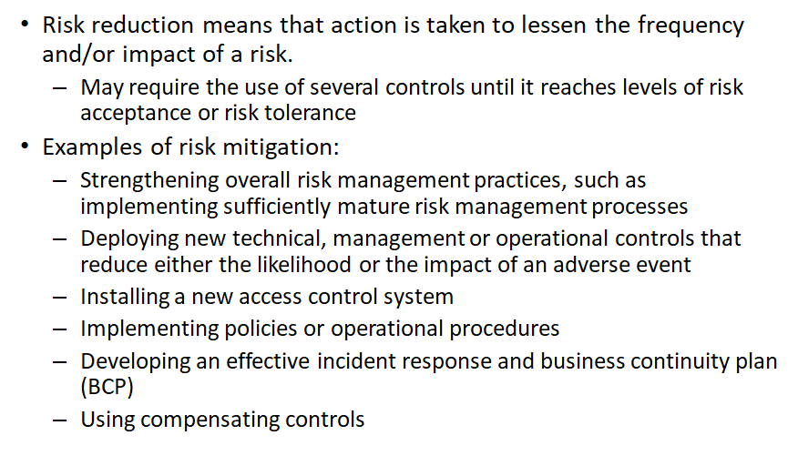
Risk Reduction/Avoidance
**The ultimate risk reduction is avoidance
Notes:
If either probability or impact is reduced to zero, there is no risk.

Slide 71
Risk Transference
Risk transference is a decision to reduce loss through sharing that risk with another organization
SLAs (Service Level Agreements) and contracts establish the degree of transference
Remember: You can’t transfer liability
Notes:
Risk transference does not (necessarily) lessen probability or impact of a risk. Just because I purchase fire insurance doesn’t make my house any less likely to catch fire. Also, the damage to the home will be the same. The fact that I can pursue financial compensation based on my loss is what risk transference indicates. Simple definition: Sharing the loss potential

Slide 72
Risk Acceptance
Examples of risk acceptance:
Provides no active mitigation
Based on a cost/benefit analysis, it is determined the cost of the control is less than the potential for loss
Sometimes acceptance is the only choice.
Risk acceptance still includes due diligence, and can still be used to indicate good business decisions were made
Level of risk and impact is always changing, so regular reviews are needed
Notes:
Risk rejection also provides no active mitigation, however, the decision is not based on due diligence, but often based on an unwillingness to examine the risks associated with an asset.

Slide 73
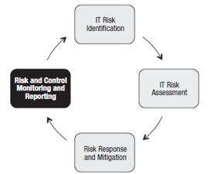
Risk Management Life Cycle:
Risk Monitoring and Reporting

Slide 74
Risk Monitoring and Reporting
•A risk response is designed and implemented based on a risk assessment that was conducted at a single point in time
•Because of the changing nature of risk and associated controls, ongoing monitoring is an essential step of the risk management life cycle.
– controls can become less effective
–the operational environment may change
and new threats, technologies and vulnerabilities may emerge

Slide 75
Key Risk Indicators (KRIs)
–Provide early warning
–Provide backward-looking view on risk events
–Enable documentation and analysis of trends
–Provide an indication of risk appetite and tolerance
–Increase the likelihood of achieving strategic objectives
–Assist in optimizing risk governance

Slide 76
Key Risk Indicators (KRIs)
Examples of KRIs:
–Quantity of unauthorized equipment or software detected in scans
–Number of instances of SLAs exceeding thresholds
–High average downtime due to operational incidents
–Excessive average time to research and remediate operations incidents
–Number of desktops/laptops that do not have current antivirus signatures or have not run a full scan within scheduled periods
•KRIs support:
–Risk appetite
–Risk identification
–Risk mitigation
–Risk culture
–Risk measurement and reporting
–Regulatory compliance

Slide 77
Risk Management Process Review
Risk Assessment
usually the most difficult to accomplish
Many unknowns
Necessary effort of gathering the right data
Risk Analysis:
can be done qualitatively and/or quantitatively
Risk Mitigation
Take steps to reduce risk to acceptable level
Risk Monitoring
***Remember - Risk must be managed, since it cannot be totally eliminated
Notes:
77

Slide 78
Legal Considerations

Slide 79
Liabilities – who is at fault?
Failure of management to execute Due Care and/or Due Diligence can be termed negligence
Culpable negligence is often used to prove liability
Prudent Man Rule
Perform duties that prudent people would exercise in similar circumstances
Example: Due Diligence: researching industry standards and best practices
Due Care: setting and enforcing policy to bring organization into compliance
Downstream Liabilities
Integrated technology with other companies can extend one’s responsibility outside the normal bounds
Notes:
Liabilities
If a company has a facility that burns down to the ground, the arsonist is only one small piece of this tragedy. The company is responsible for providing fire detection and suppression systems, fire-resistant construction material in certain areas, alarms, exits, fire extinguishers, and backups of all the important information that could be affected by a fire. If a building burns to the ground and takes all the records (information, customer data, inventory records, and the data that is necessary to rebuild), then this company did not perform its due care in ensuring that it is protected from such disasters. In this case, the employees, shareholders, customers, and everyone affected could successfully sue the company. However, if the company did everything expected of it in the previously listed respects, it could not be successfully sued for negligence and not practicing due diligence.
Due Care means that a company did all that it could have reasonably done to try and prevent security breaches, and also took the necessary steps to ensure that if a security breach did take place that the damages were much reduced because of the controls or countermeasures put into place. Due care means that a company practiced common sense and prudent management practices with responsible actions. Due diligence means that the company properly investigated all of their possible weaknesses and vulnerabilities before carrying out any due care practices. The same type of responsibility is starting to be expected of corporations pertaining to computer crime and resource protection. Computer security is developed and implemented to protect an organization’s valuable resources — thus, appropriate Liabilities.
Who is at fault?
Based on Due Care and Due Diligence
Prudent Man Rule
• Perform duties that prudent people would exercise in similar circumstances
• Downstream Liabilities
• Integrated technology with other companies can extend one’s responsibility outside the normal bounds
If the management of an organization does not practice due care and diligence, those individuals could be found negligent in their responsibilities. This deliberate behavior is considered unethical and could be illegal in certain circumstances.
Safeguards need to be in place to protect the company’s mission by protecting its tangible and intangible resources, reputation, employees, and legal position. Computer and information security is one piece of this that works as a means to an end, and not an end within itself. Security is not practiced just for the sake of doing it. Security should be practiced in a way to accomplish fully understood, planned, and attainable goals.
Senior management has an obligation to protect the company from a long list of activities that can negatively affect the company, including protection from malicious code, natural disasters, privacy violation, infraction of the law and more.
When companies come together to work in an integrated manner such as extranets and VANs, special care must be taken to ensure that each party promises to provide the necessary level of protection, liability and responsibility needed, which should be clearly defined in the contracts that each party signs. (These topics are sometimes referred to as downstream liabilities). Auditing and testing should be performed to ensure that each party is indeed holding up its side of the bargain and that its technology integrates properly with all the other parties.
The following list describes some of the actions required to show that due care is being properly practiced in a corporation:
· Physical and logical access controls
· Telecommunications security, which could require encryption
· Information, application and hardware backups
· Disaster recovery and business continuity plans
· Periodic review, drills, tests and improvement to disaster recovery and business continuity plans
· Properly informing employees of expected behavior and ramifications of not following these expectations
· Developing a security policy, standards, procedures and guidelines
· Performing security awareness training
· Running updated anti-virus software
· Periodically performing penetration tests from outside and inside the network
· Implementing dial-back or preset dialing features on remote access applications
· Abiding by and updating external service level agreements (SLAs)
· Ensuring that downstream security responsibilities are being met
· Implementing measures that ensure that software piracy is not taking place
· Ensuring that proper auditing and reviewing of those audit logs is taking place
· Conducting background checks on potential employees

Slide 80
Types of Laws
Criminal
Civil
Regulatory
Intellectual Property

Slide 81
Criminal Law
Beyond a reasonable doubt—can be difficult to meet this burden of proof in computer-related crimes
Penalties: Financial, Jail-time, death
Felonies: More serious of the two. Often penalty results in incarceration of at least a year.
Misdemeanors: Normally the less serious of the two with fines or jail-time of less than one year.
The Goal of criminal penalties is:
Punishment
Deterrence
Notes:
Criminal Law: Crimes committed against a society. Burden of proof is “beyond a reasonable doubt”. Penalties for violation of Criminal law are financial penalties, jail, and in extreme instances, death. Since the news events surrounding leaks made to the press and various news/media agencies, talks of treason and other crimes against the government have been a topic of interest. Oran's Dictionary of the Law (1983) defines treason as "...[a]... citizen’s actions to help a foreign government overthrow, make war against, or seriously injure the [parent nation]." Certain instances of computer crime could fall under this category, so penalty of death can not be ruled out as a possible option.

Slide 82
Civil (Tort) Law
Preponderance of evidence
Damages
Compensatory: Paid for the actual damage which was suffered by a victim, including attorney fees, loss of profits, medical costs, investigative costs, etc.
Punitive: Designed as a punishment for the offender
Statutory: an amount stipulated within the law rather than calculated based on the degree of harm to the plaintiff. Often, statutory damages are awarded for acts in which it is difficult to determine the value of the harm to the victim.
Liability, Due Care, Due Diligence, Prudent Person Rule are all pertinent to civil law , as well as administrative law
Notes:
Civil Law: Also known as Tort law addresses wrongful acts committed against an individual or a business, whether intentional or not. The violation must result in damage, loss, injury or death. The burden of proof requires that the jury believe in the guilt of the accused, based upon the preponderance of evidence. Simply put, this means that the evidence leads the judge or jury to a conclusion of guilt. Obviously this results in a lighter burden of proof than required in criminal court. Frequently individuals acquitted in criminal court are found guilty in civil court.

Slide 83
Administrative (Regulatory) Law
Defines standards of performance and regulates conduct for specific industries
Banking (Basel II)
Energy (EPAct) of 2005
Health Care (HIPAA)
Burden of Proof is “More likely than not”
Penalties consist of financial or imprisonment
Notes:
Administrative law encompasses the laws created by the agencies/departments of the government, and which carry out the laws passed by Congress or a particular state legislature. If Congress passes a law on a complicated issue, Congress may needs help determining the details and specifics of how that law will be enforced &implemented. Various Administrative agencies & government departments will fill in those gaps for Congress & pass additional rules & regulations to achieve the goals of Congress.

Slide 84
Intellectual Property
Intellectual Property Law
Protecting products of the mind
Company must take steps to protect resources covered by these laws or these laws may not protect them
Main international organization run by the UN is the World Intellectual Property Organization (WIPO)
Licensing is the most prevalent violation, followed by plagiarism, piracy and corporate espionage

Slide 85
Trade Secret
Resource must provide competitive value
Must be reasonably protected from unauthorized use or disclosure
Proprietary to a company and important for survival
Must be genuine and not obvious
Notes:
Intellectual Property Laws
Trade Secret
The trade secret law protects certain types of information or resources from unauthorized use or disclosure. For a company to have their resource qualify as a trade secret, it must provide the company with some type of competitive value or advantage. A resource can be protected by law if it is not generally known and if it requires special skill, ingenuity and/or expenditure of money and effort to develop it. This means that a company cannot say that the sky is blue and call it a trade secret. A trade secret is something that is proprietary to that company and important for its survival and profitability. The resource that is claimed to be a trade secret must be confidential and protected with certain security precautions and actions. A trade secret could be the recipe of a soft drink, source code of a program, method of making the perfect jellybean, or ingredients in a barbeque sauce. Many companies require their employees to sign a nondisclosure agreement contract indicating that they understand and promise not to share the company’s trade secrets with competitors. Companies do this to inform the employees of the importance of keeping certain information secret, deter the act of sharing this information and provide them the ability to fire the employee or bring charges if the employee does not uphold their part of the contract.

Slide 86
Copyright
Copyright
Copyright protections lasts for the lifetime of the author plus 70 years or 75 years for corporations
Work does not need to be registered or published to be protected.
Protects expression of ideas rather than the ideas themselves
Author to control how work is distributed, reproduced, used
Protects the expression of the resource instead of the resource itself
Two Limitations on Copyright:
First sale
Fair Use
Notes:
Copyright
In the United States, the copyright law protects the rights of an author to control the public distribution, reproduction, display and adaptation of their original work. The law covers many categories of work; pictorial, graphic, musical, dramatic, literary, pantomimes, motion picture, sculptural, sound recording and architectural. A copyright law does not cover the specific resource like the trade secret law does - instead; it protects the expression of the idea of the resource instead of the resource itself. A copyright law is usually used to protect an author’s writings, song lyrics, an artist’s drawings, a programmer’s source code or specific rhythms and structures of a musician’s creation. Names of products can be protected under copyright laws. Computer programs and manuals are just two examples of items protected under the Federal Copyright Act. The item is covered under the copyright law once the program or manual has been written. Although it is not required to include a warning and the copyright symbol, ©, it is encouraged so that others cannot claim innocence after copying another’s work. The protection does not extend to any method of operations, process, concept or procedure, but it does protect from unauthorized copying and distribution of a work. It protects the form of expression rather than the subject matter. A patent deals more with the subject matter of an invention - copyright deals with how that invention is reproduced and distributed. Computer programs can be protected under the copyright law as literary works. The law protects both the source and object code, which can be an operating system, application or database. In some instances, the law can protect not only the code, but also the structure, sequence and organization. The user interface is part of the definition of a software application structure - therefore, one vendor could not copy the exact composition of another vendor’s user interface.
Note:
Copyright act grants the owner the following rights:
Right to reproduce work
Right to prepare derivative works based on work
Right to distribute copies of work to the public
Right to perform work publicly
Right to display work publicly
Does not deal with profits of work
In the US, some extremely high value copyrights have been extended just as they were about to become part of the public domain. The Copyright Term Extension Act, extended. The Copyright Term Extension Act is sometimes referred to as the Mickey Mouse Protection Act, as it coincided with Mickey Mouse’s original scheduled entry into the public domain
Two Limitations on Copyright:
First sale: allows a legitimate purchaser of copyrighted material to sell it to another person. Example: Selling a music cd you purchased to someone else
Fair use: allows someone to duplicate copyrighted material without payment or consent. No specific guidelines for fair use—based on a judge’s decision. Considerations would include purpose, nature of work, amount duplicated, reductions in value of original work

Slide 87
Trademark
Protect word, name, symbol, sound, shape, color or combination used to identify product to distinguish from others
Protect from someone stealing another company’s “look and feel”
Corporate Brands and operating system logos
Trademark Law Treaty Implementation Act protects trademarks internationally
Notes:
Trademark
A trademark is slightly different than a copyright in that it is used to protect a word, name, symbol, sound, shape, color, or combination of these. The reason a company would trademark one of these, or a combination, is because it represents their company to a group of people or to the world. Companies have marketing departments that work very hard in coming up with something new that will make them get noticed and stand out in a crowd of competitors, and trade marking the result of this work is a way of properly protecting it and ensuring that others cannot copy and use it.

Slide 88
Patent
Originally valid for 17 years, but are now valid for 20 years
Protection for those who have legal ownership of an invention
Invention must be novel and non-obvious
Owner has exclusive control of invention for 20 years
Cryptographic algorithm
The strongest form of protection
Published to stimulate other inventions
PCT (Patent Cooperation Treaty) has been adopted by over 130 countries to provide the international protection of patents
No organization enforces patents. It is up to the owner to purse the patent rights through the legal system
Notes:
Patent
Patents are given to individuals or companies to grant the owner legal ownership and enable the owner to exclude others from using or copying the invention covered by the patent. The invention must be novel, useful and non-obvious, which means, for example, that a company could not patent air. After the inventor completes an application for a patent and it is approved, the patent grants a limited property right to exclude others from making, using or selling the invention for a specific period of time. This has been used by pharmaceutical companies where one company develops a specific drug and acquires a patent for it. This company is the only one that can manufacture and sell this drug until the stated year in the patent is up. After that, all companies are allowed to manufacture and sell this product. This also takes place with algorithms. If an inventor of an algorithm acquires a patent, they have full control over who can use it in their products. If the inventor lets a vendor incorporate the algorithm, then they will most likely get a fee and possibly a royalty fee each instance the product is sold.
Software piracy indicates that the intellectual or creative work of an author has been used or duplicated without permission or compensation to the author. It is an act of infringement on ownership rights and if someone is caught, the person could be sued civilly for damages, be criminally prosecuted, or both. Duplicate software is everywhere and software piracy is everywhere. Up until now, there have not been efficient mechanisms put into place to ensure that software could not be copied and illegally used. Companies are testing out new features, and with time, it will most likely not be as easy to illegally copy and use software as it is now. When a vendor develops an application, the program is usually licensed and not sold outright. The license agreement contains provisions relating the use and security of the software and the corresponding manuals. If an individual or company fails to observe and abide by those requirements, the license may be terminated and, depending on the actions, criminal charges may be implemented. The Software Protection Association (SPA) has been formed by major companies to enforce proprietary rights of software. The association was formed to protect the founding companies’ software developments, but it also helps others to ensure that their software is properly licensed. These are huge issues for companies that develop and produce software because a majority of their revenue comes from licensing fees. Other international groups have been formed to protect against software pirates and stealing. These include the Federation Against Software Theft (FAST), headquartered in London, and the Business Software Alliance (BSA), based in Washington, D.C. They provide similar functionality as the SPA and make efforts to protect software around the world.
Software Piracy
Intellectual or creative work of an author has been duplicated without permission or compensation
SPA, BSA, FAST – protect against piracy
Of note, in the US, drug patents give twenty years of protection, but they are applied for before clinical trials begin, so the effective life of a drug patent tends to be between seven and twelve years

Slide 89
Export/Import Restrictions
Export restriction
WASSENAAR Agreement makes it illegal to export munitions to terrorist sponsored nations
Exporting of cryptographic software is allowed to non-government end-users of other countries
No exporting of strong encryption software to terrorists states
Import restriction
In many countries, the import of cryptographic tools with strong encryption requires a copy of the private keys be provided to law enforcement
US Safe Harbor Laws
Notes:
“The Wassenaar Arrangement (WA) was founded in 1996 by a group of 33 countries including United States, Russia, Japan, Australia, and the members of the European Union. Its purpose is to control exports of conventional weapons and sensitive dual-use technology, which includes cryptographic products; ``dual-use'' means that a product can be used for both commercial and military purposes. The Wassenaar Arrangement controls do not apply to so-called intangible products, which include downloads from the Internet.
WA is the successor of the former Coordinating Committee on Multilateral Export Controls (COCOM), which placed export restrictions to communist countries. It should be emphasized that WA is not a treaty or a law; the WA Control lists are merely guidelines and recommendations, and each participating state may adjust its export policy through new regulations. Indeed, there are substantial differences between the export regulation policies of the participating countries.
As of the latest revision in December 1999, WA controls encryption and key management products where the security is based on one or several of the following:
A symmetric algorithm with a key size exceeding 56 bits.
Factorization of an integer of size exceeding 512 bits.
Computation of discrete logarithms in a multiplicative group of a field of size is excess of 512 bits.
Computation of discrete logarithms in a group that is not part of a field, where the size of the group exceeds 112 bits.
Other products, including products based on single-DES, are decontrolled. For more information on the Wassenaar Arrangement, see http://www.wassenaar.org/”
***Above source: http://www.rsa.com/rsalabs/node.asp?id=2335

Slide 90
Privacy Issues – Employee Monitoring
Notify of monitoring that may be used, or do not monitor the employees at all
Banner and security awareness
Ensure that monitoring is lawful
Do not target individuals in monitoring
Monitor work-related events:
Keystroke, Cameras, Badges, Telephone, E-mail
Local labor laws related to privacy cannot be violated
Be mindful of the reasonable expectation of privacy (REP)
Gain an employee waiver by signature on policies, etc.
Notes:
Employee Monitoring: The most important element is notification. Don’t forget the importance and effectiveness of deterrence.

Slide 91
HIPAA (Health Insurance Portability and Accountability Act)
Applies to
Health Insurers
Health Providers
Health care clearinghouses (claim processing agencies)
As of 2009, covered entities must disclose security breaches regarding personal information
Liabilities cannot be outsourced

Slide 92
Gramm-Leach-Bliley Financial Services Modernization Act
Known as GLBA
Requires financial agencies to better protect customer’s PII (Personally Identifiable Information)
Three Rules:
Financial Privacy rule-Requires financial institutions to provide information to customers regarding how PII is protected
Safeguards Rule-Requires each financial institution to have a formal written security plan detailing how customer PII will be safeguarded
Pretexting Protection-Addresses social engineering and requires methods be in place to limit information that can be obtained by this type of attack

Slide 93
PCI DSS (Payment Card Industry Data Security Standard)
Not a legal mandate
Payment Card Industry self-regulates its own security standards
Applies to any business worldwide that transmits, processes or stores payment card transactions to conduct business with customers
Compliance is enforced by the payment card vendor
Compliance requirements are dictated by the number of transactions, as well as any previous security issues

Slide 94
PCI DSS Principles
Six Core Principles:
Build and maintain a secure network
Protect cardholder data
Maintain a vulnerability management program
Implement strong access control measures
Regularly monitor and test the networks
Maintain an Information security policy

Slide 95
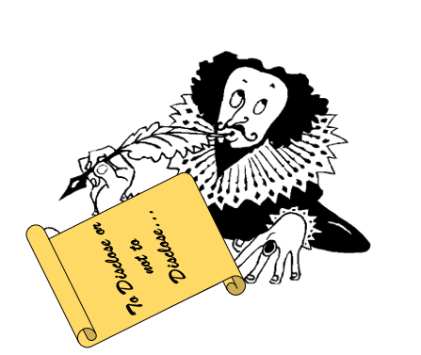
Disclosure
Notes:
Often Organizations prefer not to disclose security breaches
Advertises vulnerabilities
Causes loss of customer confidence
Liability issues
Difficulty of Prosecution
Many states have now passed disclosure laws that legally require organizations to publicly disclose security breaches that might compromise personal data
Allow individuals to take corrective action
Additional motivation for organizations to protect customer data

Slide 96
Knowledge Transfer

Slide 97

Knowledge Transfer
Awareness
To focus attention on security.
Training
To produce relevant and needed security skills and competency, often particular to a discipline
Education
To integrate all (security skills and competencies) into a common body of knowledge, adding a multidisciplinary study of concepts, issues, and principles.
Remember…
Employees cannot and will not follow the directives and procedures, if they do not know about them
Employees must know expectations and ramifications, if not met
Employee recognition award program
Part of due care
Administrative control
Notes:
97
Knowledge Transfer
Awareness is accomplished by creating an environment which values security. Security related posters that remind users of common issues and controls helps users remember to consider security. Memos that inform users of the company’s expectations, or inclusion at staff meetings can help keep security at the forefront of employee’s minds.
Training is used to provide employees with the latest information that is relevant to their jobs and responsibilities. Whether class-room or CBT-based, training is part of due care, and a valuable part of information security
Education involves making resources available to employees to extend their knowledge and have a greater comprehension of security. A technical library or online resources make information available when needed.

Slide 98
Domain 1 Review: Information Security and Risk Management
Principles of Security
Security Governance
Security strategy
Security Blueprints and Frameworks
Information Security Program
Policies, Standards, Procedures, Guidelines
Roles and Responsibilities
Information Security Risk Management
Identification
Assessment
Mitigation
Monitoring
Legal Considerations
Knowledge Transfer
Notes:
This is perhaps the most testable domain on the CISSP exam because all decisions should revolve around risk management. Don’t go too deep in the technical aspects of a problem, when instead a change in the process would be a better long term solution.

Slide 99
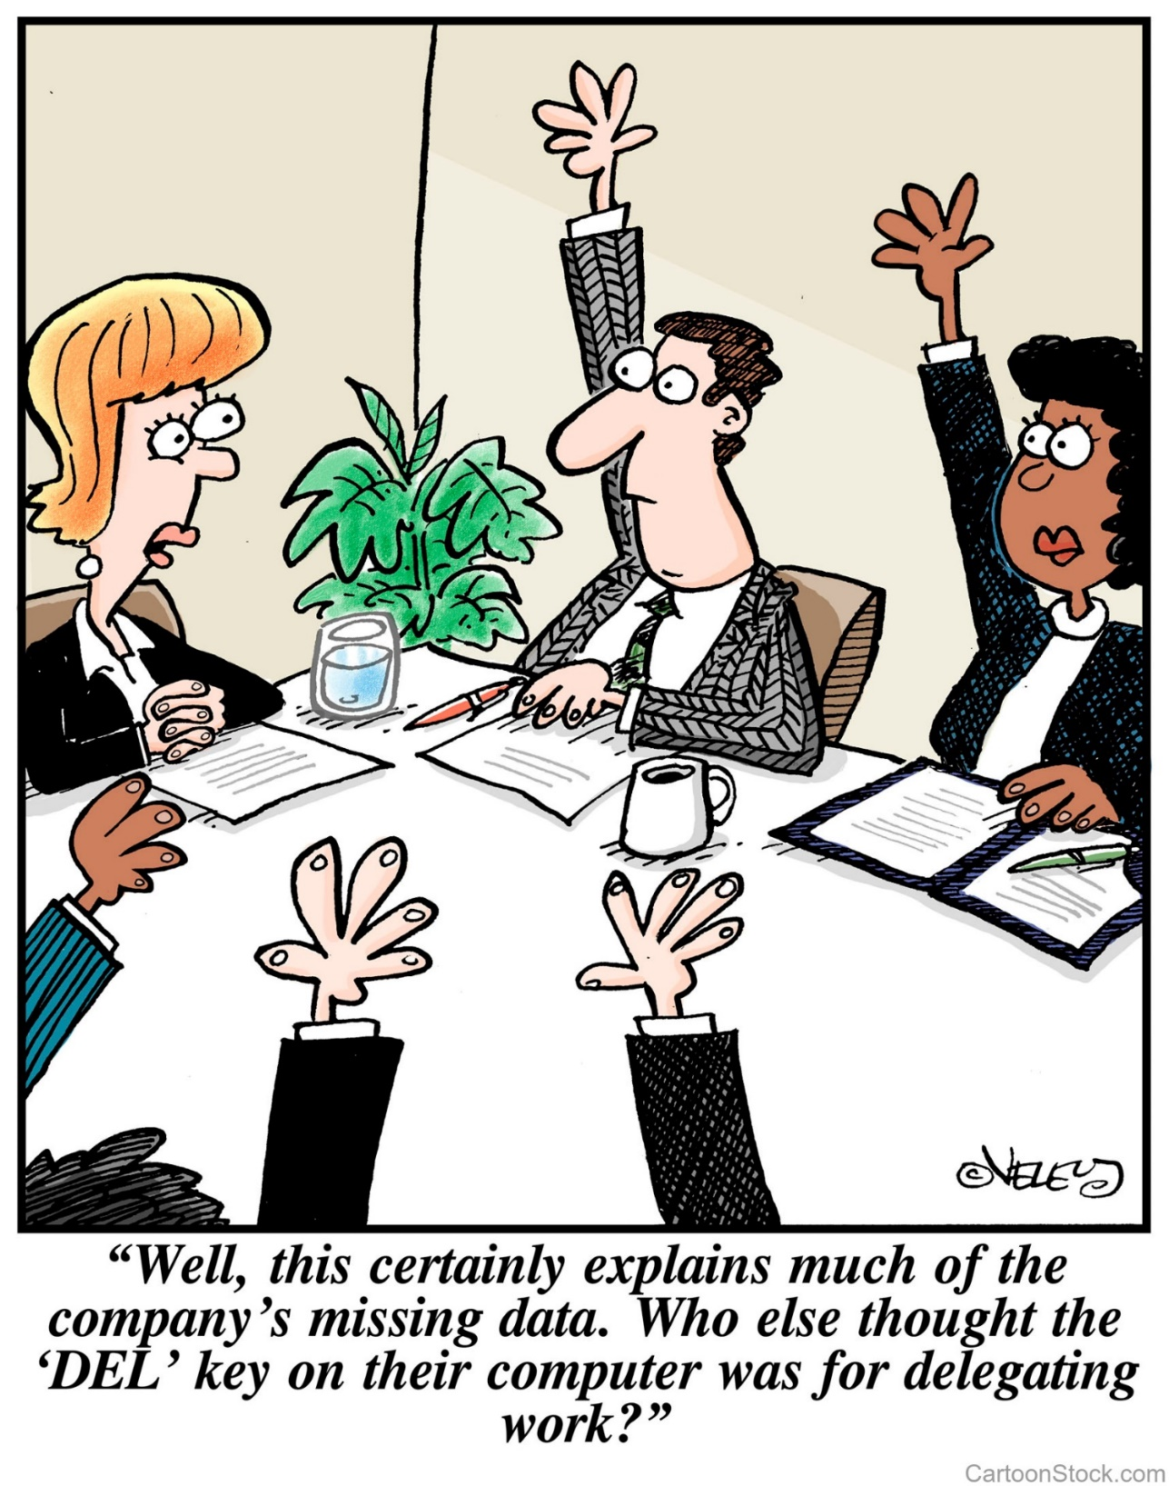
Domain 2
Asset Security

Slide 100
Asset Security Agenda
Asset Value and Classification
Data Protection
Data Redundancy
Secure Data Disposal

Slide 101
Asset Value and Classification

Slide 102
Considerations for Determining an Asset’s Value
What makes up the value of an asset?
Value to the organization
Loss if compromised
Legislative drivers
Liabilities
Value to competitors
Acquisition costs
And many others
Notes:
Asset Valuation
Elements that Determine the Value of an Asset
Three basic elements determine an information asset’s value:
1. The initial and ongoing cost (to an organization) of purchasing, licensing, developing, and supporting the information asset
2. The asset’s value to the organization’s production operations, research and development, and business model viability
3. The asset’s value established in the external marketplace and the estimated value of the intellectual property (trade secrets, patents, copyrights, and so forth)

Slide 103
Data Classification
Development of sensitivity labels for data and the assignment of those labels for the purpose of configuring baseline security based on value of data
Cost: Value of the Data
Classify: Criteria for Classification
Controls: Determining the baseline security configuration for each
Data Owner determines the classification of data
Data Custodian maintains the data
Notes:
Data Classification
The primary purpose of classifying data is to indicate the level of security to protect confidentiality, integrity, and availability of resources (CIA); that level is determined based on the sensitivity of the data. The rational behind assigning a value to data is to be able to gauge the amount of funds and resources that should go towards protecting that data. Not all data has the same value to a company. After the exercise of identifying important information, it should then be properly classified. Classification allows us to organize it according to its sensitivity to loss or disclosure.
Once data is segmented according to its sensitivity level, then the company can decide upon what security controls are necessary to protect these different types of data. This ensures that information assets receive the appropriate level of protection ; classifications indicate the priority of that security protection. The primary purpose of data classification is to indicate the level of confidentiality, integrity, and availability that is required for each type of information.
Data classification helps to ensure that the data is protected in the most cost effective manner. Security costs are come from overhead, maintenance, and funds. It is important to expect these costs for the information that actually requires this type of protection. Using our very sophisticated example of spies and peanut butter and banana sandwiches, if a company was in charge of protecting spy files, it would classify this data as “Top secret” and apply complex and highly technical security controls and procedures to ensure that it is not accessed in an unauthorized method and disclosed. On the other hand, the sandwich recipe would have a lower classification, and you might protect it by not talking about it.
Each sensitivity classification should have separate handling requirements and procedures pertaining to how that data is accessed, used, and destroyed. For example, in a Corporation, “Confidential” information may only be accessed by senior management and a select few people throughout the company. Two or more people may be required to enter their access codes to access the confidential information, the auditing may be very detailed and monitored daily, and paper copies of the information may be kept in a vault. To properly erase this data from the media, degaussing or zeroization may be required. Other information in this company may be classified as “Sensitive,” which a slightly larger group of people would be able to view. Access control on the information that is classified as “Sensitive” may require a specific set of credentials, auditing may happen but only be viewed weekly, paper copies may be kept in locked file cabinets, and the data may be deleted using regular measures when it is time to do so. Then, any remaining information is marked “Public,” all employees can access it, and no special auditing or destruction methods are required.
Note
If an auditor or vulnerability assessor needs access to data protected by logical controls, approval should be given in written form before the auditor attempts to access any information.

Slide 104
Government and Military Data Classifications
Top Secret | Grave damage to national security—Blueprints of wartime weapons, Spy satellite information
Secret | Serious Damage to national security—Troop movements
Confidential | Data exempt from Freedom of Information Act. Would cause damage to national security
Sensitive but Unclassified (SBU) | Minor Secret. No national damage. Personnel information
Unclassified | Not sensitive. Recruiting processes

Slide 105
Private Sector Data Classifications
Confidential | Company Secrets. Serious implications if this information is released.
Private | Personal information of employees within an organization
Sensitive | Financial Information, Forecasts, Project-related Information
Public | Disclosure is not necessarily welcome, but the impact would not have an adverse affect

Slide 106
Sensitivity vs. Criticality
Sensitivity describes the amount of damage that would be done should the information be disclosed
Criticality describes the time sensitivity of the data. This is usually driven by the understanding of how much revenue a specific asset generates, and without that asset, there will be lost revenue

Slide 107
Data Protection

Slide 108
Location and Access
Though the data lifecycle model does not specify requirements for location and access, these two factors are essential in planning the implementation of security controls
Location? Where is the data stored/processed/transmitted
Jurisdiction
Audit
Threat landscape
What actors have access to the data
Does data move between locations and how?
Access
Who has access to the data
What controls are in place
What devices can be used to access data

Slide 109
States of Data
At Rest: File System Encryptions, EFS, TPM
In Process: ?
In Transit: SSL/TLS, IPSec, SSH

Slide 110
System Hardening & Baselining
Removing Unnecessary Services
Installing the latest services packs and patches
Renaming default accounts
Changing default settings
Enabling security configurations like auditing, firewalls, updates, etc
***Don’t forget physical security!***
Notes:
Regardless of the function of a system, there are certain basic steps that can be taken to secure that system. Removing unnecessary applications and services is always the first step in hardening a system. Applications and services often have associated ports that are configured to “listen”. Essentially this provide an attacker with an entry point into the network.
Ensuring that the latest security patches and services packs are installed is another way to work towards creating a secure environment. Often software that is “buggy” is put on the market. Attackers will find these flaws and often will make these exploits public. In response, the vendor will create a security patch to shore up these weaknesses. If an administrator doesn’t keep up with the latest patches, then he or she will run the risk of leaving their systems exposed.
Further, keep in mind that systems are rarely configured with the most robust security settings out of the box. Often, ease of use and performance are the first considerations. Default settings and accounts, though useful, are well known and easy targets. Everyone knows the administrative account is often named simply “administrator” and many people may choose a very simple password, like “password”. These weak setting need to be modified. Personal firewalls, auditing and automatic updates should be enabled to provide extra protection. The security baseline details the minimum acceptable security configuration and must be followed.

Slide 111
Threats to Data Storage
Unauthorized usage/access
Strong Authentication
Encryption
Obfuscation, anonymization, tokenization, and masking
Organizational policies & layered Defense
Liability due to noncompliance
Due care and due diligence
SLAs
Dos and DDoS
Redundancy
Data Dispersion
Corruption, modification, destruction of data
Hashes/Digitally signed files
Data leakage and breaches
DLP
Theft or accidental media loss
TPM
Malware attack
Anti-malware
Improper treatment or sanitization of data at end of lifecycle

Slide 112
Data Security in the Cloud
Protecting Data moving to and within the cloud
SSL/TLS/IPSec
Protecting Data in the Cloud
Encryption
Detection of Data Migration to the Cloud
DAM, DLP
Data Dispersion: Data is replicated in multiple physical locations across your cloud. Is used for higher availability
Data Fragmentation involves splitting a data set into smaller fragments (or shards), and distributing them across a large number of machines.

Slide 113
Data Loss Prevention DLP
Can also be know as Data Leakage Prevention describes the controls put in place by an organization to ensure that certain types of data (SSNs, Account Numbers, etc) remain under organization controls in line with policies, standards, and procedures
Detects exfiltration of certain types of key data (SSNs, Account number, etc.)
Help ensure compliance with regulations like HIPAA, PCI-DSS and others

Slide 114
Masking, Obfuscation, Anonymization, and Tokenization
Obfuscation is the process of hiding, replacing or omitting sensitive information
Masking is the process of using specific characters to hide certain parts of a specific dataset. For instance, displaying asterisks for all but last 4 digits of SSN.
Data Anonymization is the process of either encrypting or removing personally identifiable information from data sets, so that the people whom the data describe remain anonymous
Tokenization: Public cloud service can be integrated and paired with a private cloud that stores sensitive data. The data sent to the public cloud is altered and contains a reference to the data residing the in the private cloud.

Slide 115
Data rights management
DRM or IRM (Information Rights Management) adds an extra layer of access controls on top of the data object or document and provides granularity flowing down to printing, saving, copying and other options
Useful for protecting sensitive organization content and intellectual property
ACLs are embedded into the file, it is agnostic to the location of data. IRM will travel with the file (persistent)
Dynamic policy control allows the owner to define and change user permissions and recall or expire content even after distribution

Slide 116
Data Redundancy

Slide 117
Backups and Archives
Keep Data Retention Requirements in mind
Select Backup methods appropriate with Business Objectives
Use Numbers from BIA: RTO and RPO
Remember security of backup media
Backups are copies of current data, intended for fault tolerance
Archives are data considered to be out of use, but preserved in the event that it is required at a later time

Slide 118
Data Protection policies: Retention
Data retention: Established protocol for keeping information for operational or regulatory compliance needs.
Cloud considerations:
Legal, regulatory and standards requirements must be well-documented and agreed upon
Data mapping should map all relevant data in order to understand formats, data types and data locations
Data Classification based on locations, compliance requirements, ownership and business usage
Each category’s procedures should be followed based on appropriate policy that governs the data type

Slide 119
Data Protection policies: Data archiving
Data archiving is the process of identifying and moving inactive data out of current productions systems and into specialized long-term archival storage systems. Considerations include:
Encryption
Monitoring
Granular retrieval
Electronic discovery (also called e-discovery) any process in which electronic data is sought, located, secured, and searched with the intent of using it as evidence in a civil or criminal legal case
Backup and recovery
Media Type
Restoration procedures

Slide 120
Secure Data Disposal

Slide 121
Sanitizing Media
What types (e.g., optical non‐rewritable, magnetic) and size (e.g., megabyte, gigabyte, and terabyte) of media storage need to be sanitized?
What is the confidentiality of the data stored on the media?
Will the media be processed in a controlled area?
Should the sanitization process be conducted within the organization or outsourced?
What is the anticipated volume of media to be sanitized by type of media?
What is the availability of sanitization equipment and tools?

Slide 122

Media Sanitation
Data
Media
Magnetic Optical
Electrical
Hard copy
Electronic copy
Disposal, Clearing, Purging, Destroying

Slide 123
Removing Data Remnants
Disposal
Clearing—overwriting—renders data in accessible by normal means
Purging—degaussing—renders media unusable by normal means
Destruction—Physical destruction Irreversible by all known techniques

Slide 124
Asset Security Review
Determining the Value of Assets
Classification of Data
Data Security Lifecycle
Security Across Data States
In Storage
In Process
In Transit
Data Lifecycle SecurityStorage Architectures
Data Retention
Database Security
Data Loss Prevention (DLP)
Data Encryption
Key Management
Secure Data Disposal

Slide 125
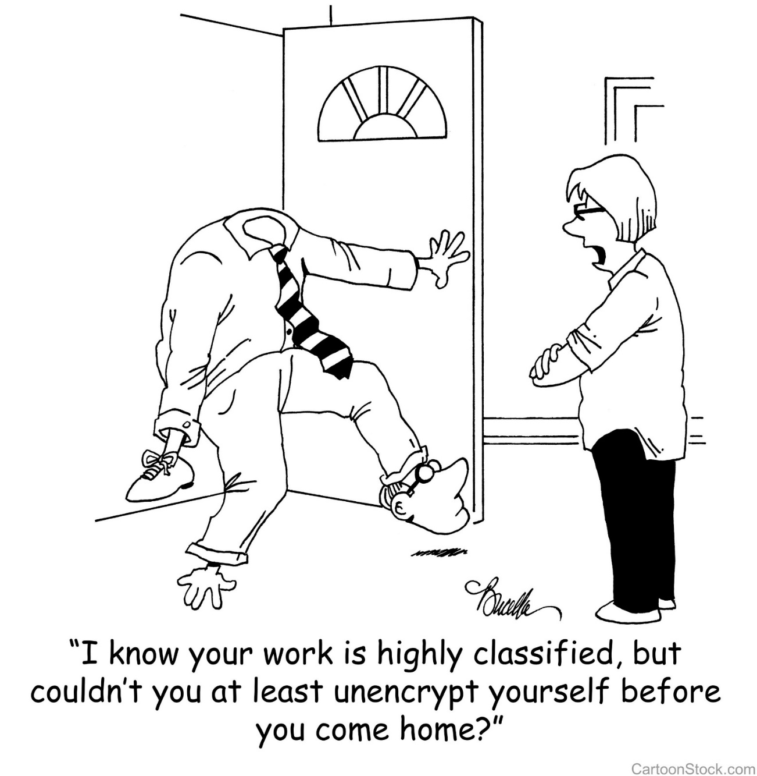
Domain 3 Security Architecture and Engineering
Part 1 : Cryptography

Slide 126
Module 3 Security Engineering and Architecure Part 1: Cryptography
Cryptography Through History
Cryptography Basics
Symmetric Cryptography
Asymmetric Cryptography
Hybrid Cryptography
Public Key Infrastructure
MACs
IPSec
Email Cryptosystems
Attacks on Cryptography

Slide 127
Cryptography Through History

Slide 128
Cryptography in History
Caesar Cipher
Scytale
Vignere
Vernam
Enigma Machine and Purple Machine

Slide 129
Caesar Cipher
Simple Substitution
Shift Characters 3 spaces
A=D, B=E, C=F, etc
Substitution Ciphers are subject to pattern analysis

Slide 130
Scytale
Spartans used this cipher to communicate messages to generals in the field
Wrapped tape around a rod
Diameter of the rod is the pre-agreed upon secret (key)

Slide 131
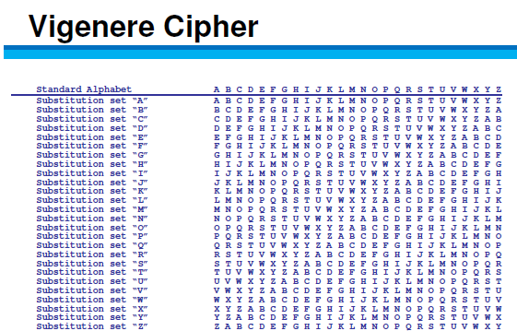
Vignere
First polyalphabetic cipher
Key word is agreed upon ahead of time
First letter of the key is matched up against first letter of the message, and so on

Slide 132
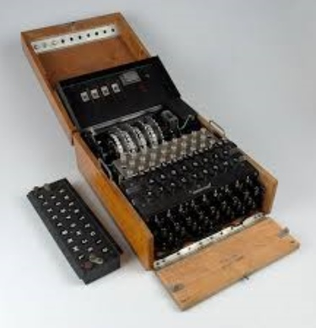
Cryptography in Warfare
Enigma Machine/Purple Machine
Used by the Germans/Japanese in WWII
Breaking the cryptography of these devices is credited with reducing the length of the war.

Slide 133
Vernam Cipher
One Time Pad
Only mathematically unbreakable form of cryptography
Key must be used only once
Pad must be at least as long as the message
Key pad is statistically unpredictable
Key Pad must be delivered and stored securely

Slide 134
Cryptography Basics

Slide 135
Security Services provided by Cryptography
Privacy: Prevents unauthorized disclosure of information
Authenticity: Verifies the claimed identity
Integrity: Detects modification or corruption
Non-Repudiation: Combines authenticity and integrity. A sender can’t dispute having sent a message, nor its contents.

Slide 136
Definitions and Concepts
Plain Text + Initialization Vector + Algorithm (aka Cipher) + Key
=
Cipher Text

Slide 137
Initialization Vector
Here are some random numbers (I promise, they’re really random!)
7 5 2 3 4 9 4
If we start at track 0 and +7 +5 – 2 +3 + 4 +9 -4
We still don’t have randomness. Vary the starting point and that will make the process more random
Very similar to a “seed” or a “salt”

Slide 138

Algorithm

Slide 139
Elements of Cryptography
Desirable Qualities of an Algorithm
Confusion
Diffusion
Chaining
Permutations
Open—Kerchoff's Principle
Desirable Qualities of a Key
Long
Random
Secret

Slide 140
Definitions and Concepts
Plain text is unencrypted text
Initialization Vector (IV) adds randomness to the beginning of the process
Algorithm is the collection of math functions that can be performed
Key: Instruction set on how to use the algorithm

Slide 141
Symmetric Cryptography

Slide 142
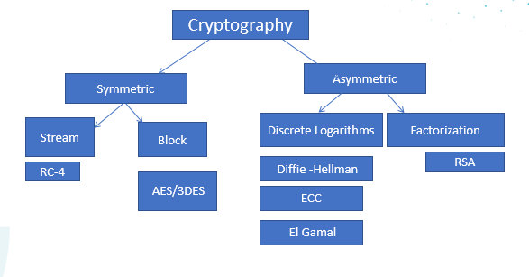
Cryptography

Slide 143
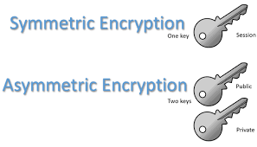
Cryptography Overview
Symmetric Cryptography
Pros
Provides FAST data transfer
Good strong privacy
Cons
Out of band key distribution
Doesn’t scale well
Doesn’t provide non-repudiation
Can be called “Secret,” “Private,” “Shared,” or “Session” Key
A single key is shared by both parties and is used to encrypt and decrypt
Symmetric ciphers are either
Stream (One bit at a time)
Block (chunks of data)
Asymmetric Cryptography
Every user has a “key pair” which consists of a public and a private key
Anything encrypted with one key can only be decrypted by the other. More on this later!

Slide 144
Symmetric Cryptography: Stream vs. Block
Stream Ciphers encrypt one bit (up to one byte) of data at a time.
Transposition, Substitution, XOR
Very fast and efficient
Not as Secure
RC-4 is the only stream cipher necessary for the test
Block Ciphers chunk data into blocks. Each chunk goes through a series of math functions called S-boxes

Slide 145
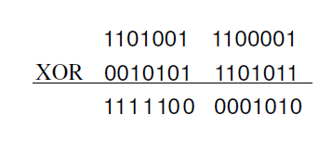
Stream Ciphers XOR
If Values are:
Alike 0
Different 1

Slide 146
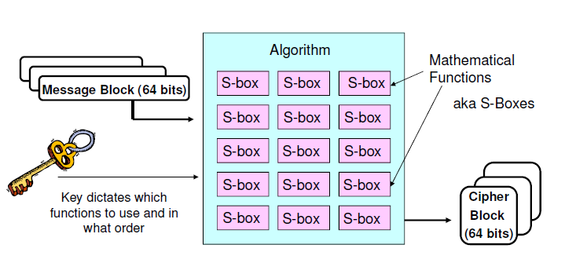
Block Ciphers

Slide 147
Common Symmetric Algorithms
Blowfish
IDEA
CAST
MARS
Skipjack
DES
3DES
AES
RC-4
RC-5
Two Fish

Slide 148
Asymmetric Cryptography

Slide 149
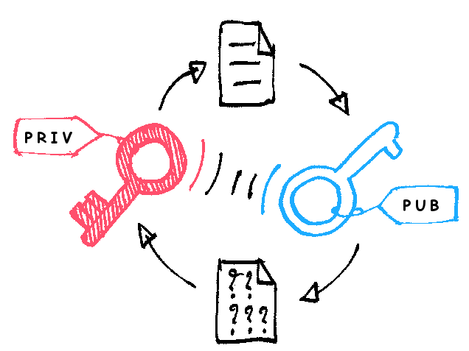
Asymmetric Cryptography
Every user has a key pair.
Public key is made available to anyone who requests it
Private key is only available to that user and must not be disclosed or shared
The keys are mathematically related so that anything encrypted with one key can only be decrypted by the other.

Slide 150
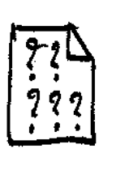
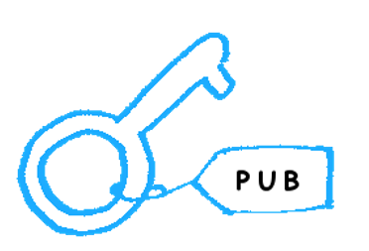
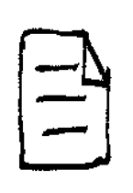

Privacy through Asymmetric Cryptography
Receiver’s
Sender encrypts message with receiver’s
Public Key
EncryptedMessage
Receiver decrypts message with receiver’s
Private Key
Receiver’s
Decrypted Message

Slide 151
Authenticity through Asymmetric Cryptography
Sender encrypts something small and meaningless (timestamp) to an attacker with Sender’s Private Key
Sender’s Private
Timestamp, (not message)
Receiver decrypts timestamp with Sender’s
Public Key, proving it had to have been encrypted by Sender’s private key
Sender’s Public
Timestamp, (not message)
Being able to decrypt the timestamp with Sender’s public key PROVES it was encrypted with Sender’s private key
Notes:
What are we trying to prove? The AUTENTICITY of the SENDER. What does the sender have that no one else does? Sender’s private key. Why must what’s encrypted be meaningless to an attacker? Because anyone with the sender’s public key can decrypt it. Remember, this is not about privacy. The sender just needs something to encrypt with its private key. If the Sender’s public key can decrypt, it CAN ONLY have been encrypted with the sender’s private key, which proves it came from the sender.

Slide 152
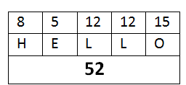
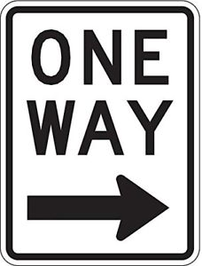
Hashing (Checksums/Message Digests)
Fixed length digital representation of the contents of the file
If the file changes, the hash will change
One-way math
When two different documents produce the same hash it is called a collision
A birthday attack is an attempt to cause collisions. It is based on the idea that it is easier to find two hashes that happen to match than to produce a specific hash.
If an attacker has the ability to change the message, why wouldn’t they change the hash also? THEY WOULD. So……remember this for later.
MD-5 128-bit
SHA-1 160-bit
SHA-2 256, 384, 512, etc.
HAVAL, TIGER, RIPEMD are lesser known hashing algorithms

Slide 153
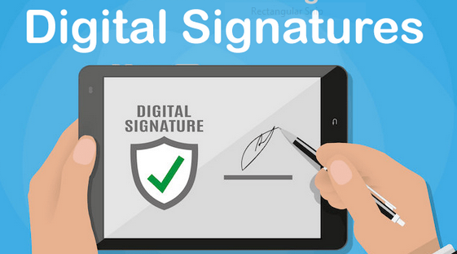
Non-Repudiation
Sender hashes document for integrity
Hash is encrypted with SENDER’S PRIVATE Key
Message is sent to user, who tries to decrypt the hash with the SENDER’S PUBLIC KEY. Only something that was encrypted by the sender’s private key can be decrypted with the sender’s public. This proves the authenticity of the sender
Sender encrypts the hash with Sender’s Private Key

Slide 154
Asymmetric P.A.I.N
Privacy: Receiver’s Public Key
Authenticity: Sender’s Private Key
Integrity: Hash/checksum/CRC—neither symmetric nor asymmetric
Non-Repudiation: Hash encrypted by sender’s private key

Slide 155
Common Asymmetric Algorithms
DSA
RSA
ECC (Elliptical Curve Cryptography)
El Gamal
Diffie Hellman
Knapsack

Slide 156

The Buddy System for Asymmetric Algorithms
RSA and DSA
ECC and El Gamal)
DH (Diffie Hellman) and Knapsack

Slide 157
RSA
Named for Rivest, Shamir, and Adleman, the creator
Currently the standard for Digital Signatures
Uses the idea that there is no efficient way to factor the product of large prime numbers
The math used for RSA is sometimes referred to as a trap-door function
****Factorization*****
Notes:
Y

Slide 158
Diffie-Hellman
The first asymmetric algorithm
Secure key-agreement without pre-shared secrets
Based on discrete logarithms in a finite field

Slide 159
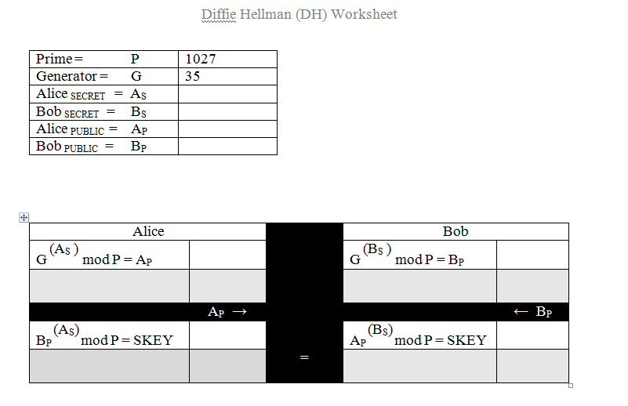
Diffie Hellman Key Agreement

Slide 160
ECC (Elliptical Curve Cryptography)
Based upon plotting points along a curve
Very efficient, but only applicable for key agreement, digital signatures, pseudo-random generators and other tasks
Frequently used for handheld devices due to their limited processing capability

Slide 161
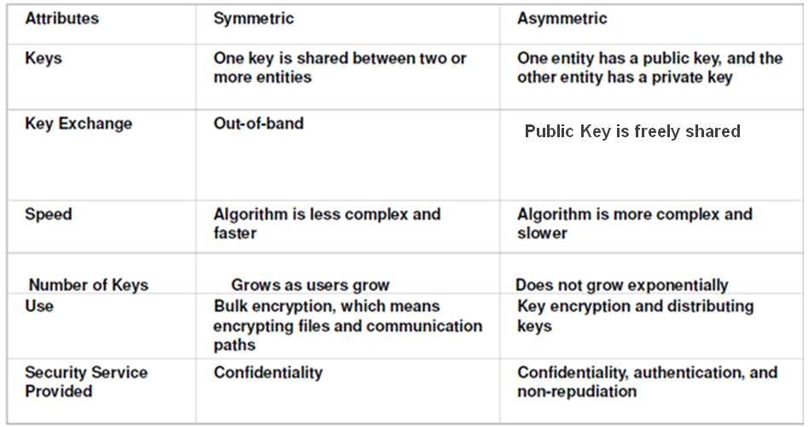
Summary of Symmetric vs. Asymmetric

Slide 162


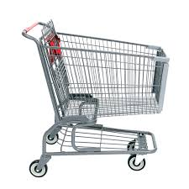
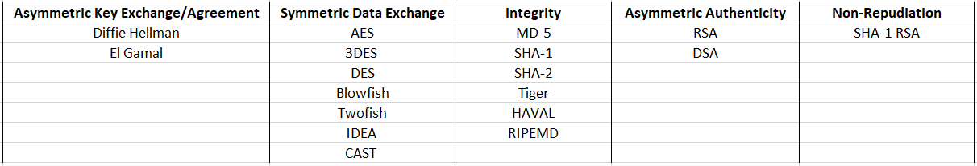
CRYPTO-MART

Slide 163
Hybrid Cryptography

Slide 164
Hybrid Cryptography
What We’d Like to Achieve
Privacy
Authenticity
Integrity
Non-Repudiation
SPEED
Our Problem: Neither Symmetric nor Asymmetric can provide ALL these services

Slide 165
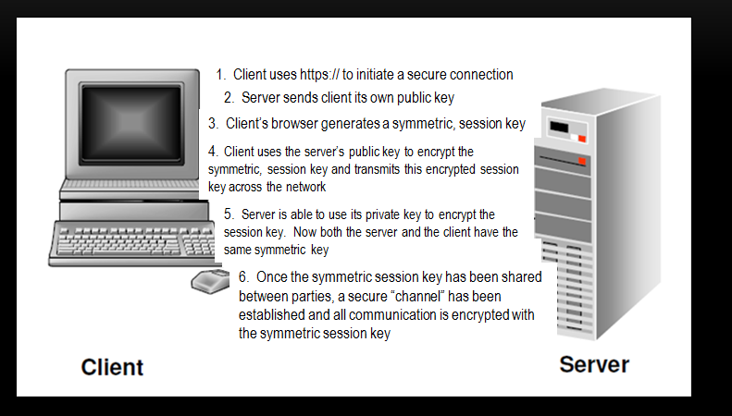
SSL/TLS Hybrid Cryptography
(8675309)
(8675309)

Slide 166
SSL/TLS Hybrid Cryptography
Client initiates a secure connection
Server responds by sending it’s public key to the client
The client then generates a symmetric session key.
Client encrypts uses the server’s public key to encrypt the session key.
Client sends the session key (encrypted with the server’s public key) to the server
Server uses it’s private key to decrypt the session key
Now that a symmetric session key has been distributed, both parties have a secure channel across which to communicate.

Slide 167
Public Key Infrastructure

Slide 168
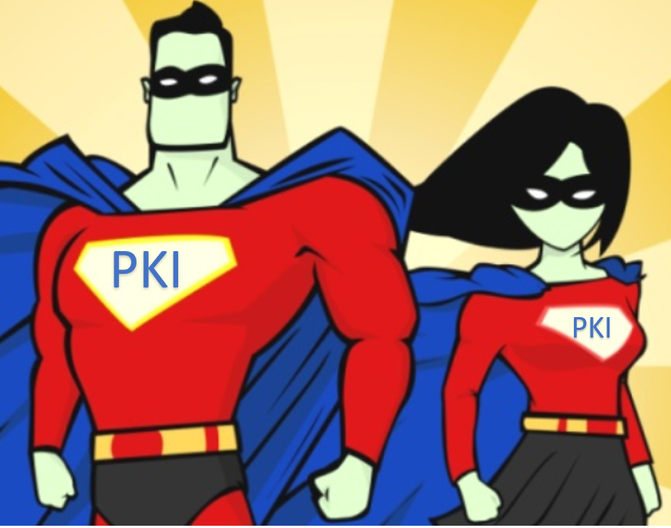
Sounds Good, but….
How does the server get a key pair?
What happens if keys are compromised?
How do we know we have compatible software to exchange keys?
Do keys ever expire?
How would we renew them?
Stay tuned to the answers to these and many more questions…

Slide 169
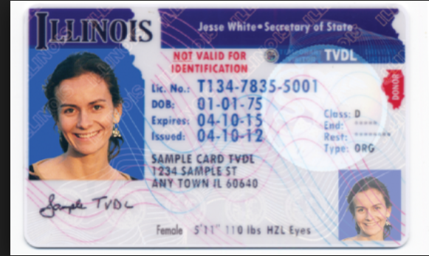
How Do we Prove our Identity?
Name?
Expiration Date
Class?
Serial Number?
Is it standardized?
Is it issued by a trusted authority?

Slide 170
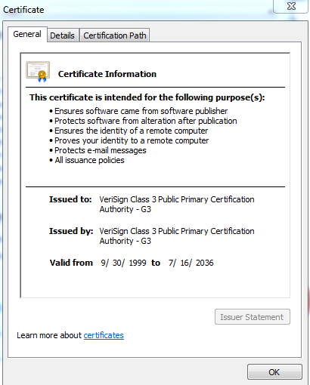

Certificates
X.509 v.4 standard
Provides authenticity of a server’s public key
Necessary to avoid MITM attacks with server’s using SSL or TLS
Digitally signed by Certificate Authority

Slide 171
PKI (Public Key Infrastructure)
Certificate Authority (CA)
Registration Authority (RA)
Certificate Repository
Certificate Revocation List

Slide 172

Certificate Contents

Slide 173
Certificate Revocation
CRL: CA publishes CRL. Client is responsible for downloading to see if a certificate has been revoked.
OCSP (Online Certificate Status Protocol) Streamlines the process of verifying whether or not a certificate has been revoked.

Slide 174

Trusted Certificate Authorities

Slide 175

OCSP (Online Certificate Status Protocol)

Slide 176
MACs (Message Authentication Codes)

Slide 177
Integrity
Data could be modified
Accidentally through corruption
Intentionally through malicious alteration
Hash: only good for accidental modification
MAC: Provides reasonable authenticity and integrity not strong enough to be non-repudiation (because it uses a symmetric key)
Digital Signatures: Can detect both malicious and accidental modification, but requires an overhead. Provides true non-repudiation

Slide 178

Quick Integrity Review
Hashing is only good for accidental modification/corruption, because a malicious attacker would simply modify the hash to evade detection
Digital Signatures use the sender’s private key + a hash to guarantee the integrity AND the origin of a message…but it requires lots of OVERHEAD of a Public Key Infrastructure

Slide 179
MAC (Message Authentication Code)
Message + Symmetric Number +Hashing algorithm
= HMAC
Integrity and (reasonable) authenticity
A MAC does not provide true authenticity (symmetric)

Slide 180
IPSec

Slide 181
IPSec
Provides the framework for services such as encryption, authentication, integrity (any or all of these services may be provided)
IPSec provides encapsulation, not encryption
What is encapsulated can be protected through the protocols within IPSec

Slide 182




Encapsulation: Packaging (Not Encrypting)
Think about shipping something fragile… for instance, Champaign glasses. You could just stick a stamp on them, but they would break….so, you add packaging them up to get to the correct destination safely and intact.
We wrap Champaign glasses in bubble wrap to protect them
Then we put the glasses in a box with bubble wrap
We gift wrap the box and write, “Best wishes, Uncle Steve!”
We put that box in a bigger box with packing peanuts for more protection
We put that box in a Fed Ex box with a Fed Ex label to provide information for the package to traverse the carrier’s network
We hand off the package to Federal Express and the champaign glasses are on their way!
Missing step: Remove Pug from bubble wrap
Missing Step: Remove Cat from Packing Peanuts

Slide 183

IPSEC
IPSEC is an encapsulation framework. Tunnel vs. Transport mode dictates what portion of the IP Packet is to be encapsulated.

Slide 184
IPSec Sub-protocols
AH (Authentication Header) Provides integrity, authenticity, and non-repudiation through the use of an ICV (Integrity Check Value). The ICV is run on the entire packet (header, data, trailer) except for particular fields in the header that are dynamic (like TTL, etc). NO CONFIDENTIALITY
ESP (Encapsulating Security Payload) Provides authenticity and integrity through a MAC (no non-repudiation since a MAC is symmetric). The main service provided is ENCRYPTION. ICV is run on payload only.
IKE: Internet Key Exchange---No Security Services. Just management of secure connection
Oakley: Uses Diffie Hellman to agree upon a key
ISAKMP (Internet Security Association and Key Management Protocol) Manages Keys, Security Associations (SAs)and Security Parameters Index (SPI)
Notes:
IPSEC (Internet Protocol Security) Made up of several sub-protocols:
AH: Provides Authentication and Integrity. To provide integrity, AH uses an ICV (Integrity Check Value), which is essentially the same as a Message Authentication Code (provides system based, aka data origin authentication). This integrity check is performed on the whole packet, not just the data. This ensures that neither the data nor headers/trailers have been altered. This can cause problems with NAT.
ESP (Encapsulating Security Payload) provides encryption, authentication, and integrity checking on just the payload, so it is compatible with NAT.
IPSEC can operate in transport or tunnel mode. Transport mode is used for securing communications between end users on a network. Just the payload is encrypted.
Tunnel Mode is for securing WAN communication. Data, headers, trailers encrypted.
An SA (Security Association) functions in a manner similar to a socket. It tracks each secured session and contains information about that session and allows multiple IPSec connections to/from the same system. Each connection has two SA’s, one on each end. Computer A will have an SA to identify connection1 to Computer B—that SA might be called “1234”. Computer B will have an SA to identify it’s session with Computer A. That SA could be called “4321”. The point is, though the SA is known by different “names” on each computer, it’s really identifies the one connection.
There are two ways IPSEC manages keys. Each device wishing to communicate can be configured with a symmetric key, SA info, and other info. Or, the Internet Key Exchange (IKE) can be used. IKE is made up of two protocols, ISAKMP—Internet Security Association and Key Management Protocol-- and Oakley). How does this come into play?
If I want to establish a secure VPN connection between two routers, those routers will use a handshaking process to exchange security parameters like algorithms, key size, etc. This is information that you would not want a hacker to acces. Here’s where IKE comes in. First IKE is used to establish a secure channel between the routers. It uses Diffie Hellman to get a secure session key on each end. Second, that session key is used to encrypt VPN parameters. These parameters are stored as a part of the SA. Now, the data can be transmitted securely.

Slide 185

Security Associations and SPIs
Security Association
There will be at least two SAs for every secure connection

Slide 186
Email Cryptosystems

Slide 187
Implementation of Cryptography: Digital Envelopes in S/MIME
S/MIME (Secure Multipart Internet Mail Exchange) :
Standards based secure email by creating a digital envelope
Sender functions:
Calculate hash value on message
Encrypt message with session key
Encrypt hash value with private key
Encrypt session key with receiver’s public key
Receiver functions:
Decrypt session key with private key
Decrypt hash value with sender’s public key
Decrypt message
Calculate hash value and compare with one sent

Slide 188
Implementation of Cryptography: PGP (Pretty Good Privacy)
Proprietary mail standard from Phil Zimmerman
Free, but proprietary software must be installed
Uses Web of Trust
Passphrases instead of passwords
Learned keys are stored in a file called the key ring

Slide 189
Attacks on Cryptography

Slide 190
Attacks on Cryptography
Ciphertext Only: Attacker has captured encrypted text on the network. Usually means all the attacker can do is brute force
Known Plain Text: The attacker has captured cipher text, but also knows what a portion of the message is in plain text (like an automatic signature)
Chosen Plaintext: Attacker can see the full text encrypted and decrypted. Usually the attacker has initiated the message
Chosen Ciphertext: An attacker can see whatever they want in plain or ciphertext. They have compromised a workstation. Sometimes called a lunchtime or midnight attack.

Slide 191
Attacks on Cryptography Continued
Meet in the Middle (Not to be confused with Man in the Middle). These attacks are targeted towards algorithms like 3DES where there are multiple key. An attacker tries to learn what each key does individually.

Slide 192
Cryptography Review
Cryptography throughout History
Cryptography Basics
Symmetric Cryptography
Asymmetric Cryptography
Hybrid Cryptography
Public Key Infrastructure
MACs
IPSec
Email Crytography
Attacks on Cryptography

